Slide 1
Providing Care in a New Environment: Immigration Policy
Matthew Lopas, Director of State Advocacy January 29, 2025

Slide 3
Disclosure & Disclaimer
Disclosure:
The presenter has no relevant financial relationships or conflicts of interest to disclose related to the content of this presentation.
Disclaimer:
The materials and information provided during this presentation are for general informational purposes only. You should not consider nor act or refrain from acting upon them as legal advice. Your receipt of the information and materials, and any communication during the presentation does not create an attorney-client relationship.

Slide 4
Agenda
Recent changes in law and policy regarding immigration
Legal framework for care of immigrant patients
Creating safe spaces for care delivery

Slide 5
Changes in Law & Policy

Slide 6
Rescinding Protected Areas Memo
Withdrew guidance dating back to 2011 regarding immigration enforcement actions in areas known as sensitive locations or protected areas
Previously shielded locations such as health care facilities, places of worship, schools, shelters, etc.
Eliminated policy of DHS, but did not affect the law governing access to these locations

Slide 7
Immigration Enforcement Changes
Enforcement efforts increasingly focused on tracking down individuals and arresting in communities (as opposed to those already in law enforcement custody), which ICE acknowledges are more unpredictable and dangerous
Executive orders lead to more severe consequences for interaction with immigration enforcement increases in use of detention, expansion of expedited removal (deportation without judicial proceedings), and deportation to third country
Ending of temporary protected status, parole, and other forms of temporary status for many individuals, rendering additional people undocumented
Greater variation in experience and training in interior immigration enforcement with hiring of 12,000 ICE officers but training cut to less than half; deployment of Border Patrol agents in large numbers across the country; and use of other federal agents including FBI, DEA, AFT, and even IRS.

Slide 8
Changes to Health Access Issues
Proposed new rule for Public Charge would eliminate regulations without a replacement, leaving to later guidance that is suggested to drastically expand the scope of consideration and leave to the discretion of adjudicators
2025 budget law revoked access to Medicaid, Medicare, CHIP, ACA subsidies, and programs like SNAP for many lawfully present immigrants (undocumented people were already barred)
Redefining of “public benefits” by agencies could prevent undocumented people from safety net options, driving more to hold out for emergency care

Slide 9
Legal Framework

Slide 10
Legal Protections
Governed by the Fourth Amendment protections against unreasonable search and seizures
Is there a reasonable expectation of privacy in an area?
Items in “plain view” are deemed not “private”; can make “collateral” arrests
Privacy rights affect patients but held by health care facility/office
Health care providers have no affirmative legal obligation to inquire into and report to federal immigration authorities about a person’s immigration status

Slide 11
HIPAA & Privacy Protections
HIPAA stands for the concept that health care providers should not share personal health information about patients; in the context of records held by health care providers, the Fourth Amendment is the stronger legal concept health care providers can exercise to limit sharing.
Law enforcement of HIPAA may apply, but if so it does not require providers to share any information about immigration status, it merely allows compliance with something like a judicial warrant without violation of HIPAA obligations
Patients who are in ICE custody maintain HIPAA rights and obligations can be complicated with presence of ICE officers

Slide 12
How Do Health Care Providers Fit
Rights
Responsibilities
Right to a reasonable expectation of privacy, including limiting access to private spaces without a judicial warrant
Right to remain silent
Right to document and record (when not violating patient rights)
Right to invoke and enforce their own Constitutional rights
Right to make information about rights accessible broadly to patients
Provide quality health care to patients under your care
Follow ethical and legal obligation
Consider how invocation of own constitutional rights affects patients
Comply with complete, accurate, and judicially approved warrants (within their scope)
Refrain from interfering with an arrest in process

Slide 13
Creating Safe Spaces

Slide 14
Privacy Rights in Health Care Facilities
Right to refuse entry: Health care providers may refuse to allow entry by law enforcement officials into private areas without a proper judicial warrant signed by a judge unless an authorized person consents
Right to refuse access to information: Health care providers may refuse to provide information about patients to law enforcement officials unless the request is pursuant to a warrant issued by a judge or magistrate for a specifically identified individual or another order issued by a court, unless an authorized person consents
If you do not invoke these rights, you give up the right of privacy affecting your health care facility and your patients

Slide 15
How to prepare and enforce
Establish private spaces and records: Establish and clearly label areas where patients and their family/care partners have private spaces that are not accessible to the general public (e.g. exam rooms, waiting rooms). If your facility limits access to protect patients from protestors, you have done something similar.
Avoid collecting immigration status information: Avoid asking about status if it is not necessary and, if you must collect such information for purpose such as Medicaid enrollment, avoid including that information in the patient’s medical and billing records.
Identify an authorized person: Facilities should designate specific staff to act as authorized person in such situations and ensure these individuals can identify a valid warrant and know the legal rights and requirements of the facility. Private practices identify a person in charge and/or contracted attorney.
Train staff: Staff must be careful to follow, avoid any action that could be interpreted as consent, and refer agents to the authorized person. This includes front desk and security guards, who may be aided by a script. There are requirements that must be followed, but they should also be aware of ruses and tactics to gain entry.
Inform patients: Provide material (in accessibly language) that provides information to patients about their rights and communicate your facilities’ plans.

Slide 16

What a private space looks like
Clearly marked signage that labels areas as inaccessible to the general public
A closed door separates public area from private areas
A person must have to be granted entry or escorted into the private space, such as calling someone in from a waiting room
Additional levels of privacy may exist: a person may be granted access to a hospital ward but not to every patient’s closed door

Slide 17
During enforcement action
Agents could show up from ICE, CBP, or other government agencies (such as DEA), or even local police in some cases. Staff should follow guidelines for any agents
Stay calm, professional, and respectful.
Request and record the officers’ agencies, names, and badge numbers
Contact the authorized person/team and inform agents that only that person can authorize entry or access
Authorized individual should evaluate any warrants to ensure it is a judicial warrant signed by a judge or magistrate, that it is complete, and to determine its scope
Authorized person should comply with valid warrants, monitor the agents, and can again refuse entry or access to anything beyond the warrant’s scope
Take notes and document the actions
You can videotape the enforcement action (if not violating other obligations) but do NOT interfere/obstruct the agents or assist them. Keep focus on agents, don’t share right away, and don’t edit.

Slide 18
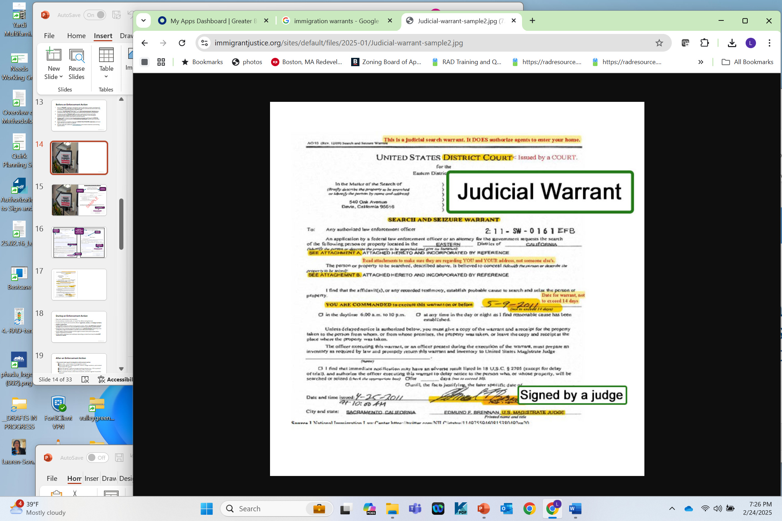
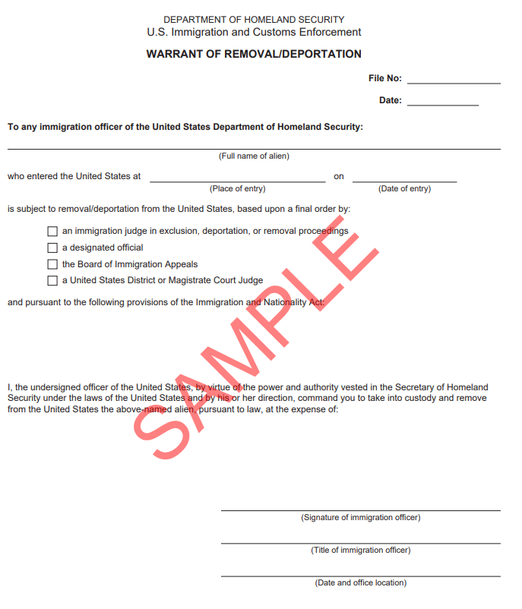
Review
Warrants
Is it a valid judicial warrant
Is it signed by a judge or magistrate judge
Does it state the address of the specific premises to be searched
Is it being executed during the time period specified on the warrant (if any)
Custodial and removal authority
Issued by DHS/ICE, not a federal court

Slide 19
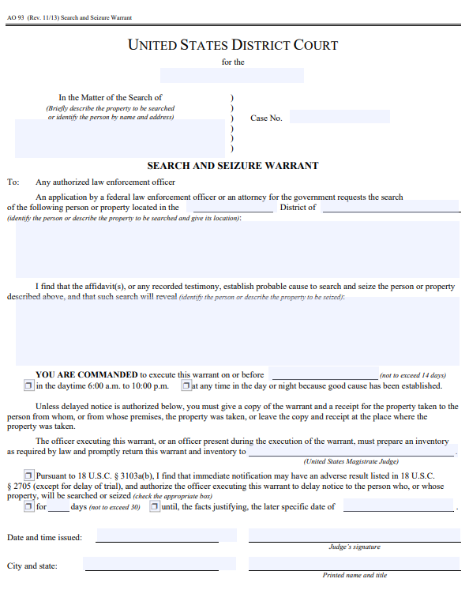
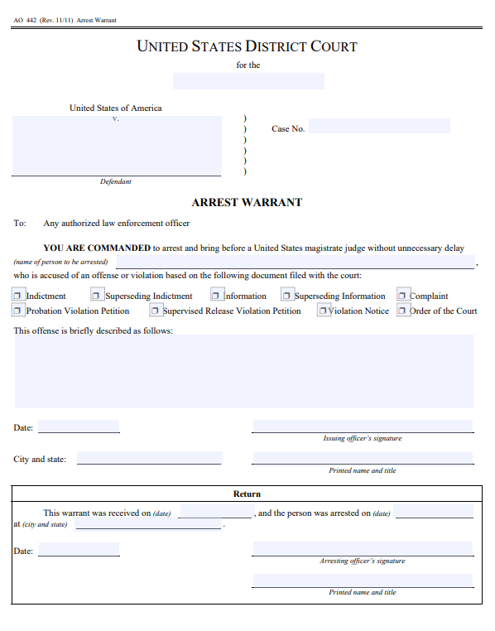
Must identify property or person and address to be searched and seized
JUDICIAL WARRANT ISSUED BY FEDERAL DISTRICT COURT
Must specify name of person to be arrested
Lists time and date within which search must take place
Signed by federal magistrate, judge, clerk, or other court officer
Signed by U.S. magistrate or district court judge

Slide 20
Safe & effective patient experience
Be careful in record keeping: Avoid recording information about immigration status or place of birth in patient records.
Provide educational material: Put up posters and provide materials advising patients that they have the right to refuse to answer questions and insist on a lawyer. You can remind people of this right.
Reassure your patients: Educate and reassure that their health care information is protected by federal and state laws and that you are taking proper care of it.
Be aware of language access and culturally competent care: Meet your patients where they are so you can communicate with your patients.

Slide 21
Thank You
Resources:
KYR: Health Care Providers & Immigration Enforcement
KYR: Health Care and Health Insurance for Immigrants
KYR Under the US Constitution (general)
Matthew Lopas
Director of State Advocacy
lopas@nilc.org

