Slide 1


State and Federal Budget Changes: Medi-Cal Impacts to Know About
By Jack Dailey
January 2026

Slide 2


Health Advocacy through HCA
Since 1998 HCA’s experienced health care attorneys have helped Californians obtain and maintain coverage and overcome barriers to necessary care.
Consumers living in any area of the state can get individual assistance by calling 1-888-804-3536 and providing their zip code. All services are free.
CCHEA (San Diego) – 1-877-734-3258
HCA serves as DHCS Medicare Medi-Cal Ombuds Program (MMOP) and Consumer Assistance Programs (CAPs) for Covered California and DMHC

Slide 3


Agenda:
A note on changes impact BH
Primer on Medi-Cal impacts from State and Federal Budget Policy
Overview of GAC attacks

Slide 4

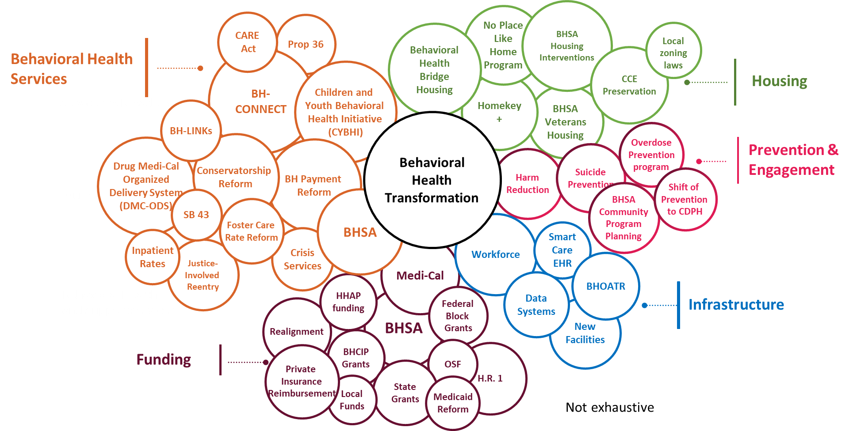

Statewide Changes Impacting County
Behavioral Health
4
Notes:
Excerpted from a presentation deck that Nadia Privara (new BH Director in County of San Diego) recently presented to the CA BH Planning Council, Jan 21, 2026.
Dizzying array of changes impacting delivery of BH in counties. BHSA Integrated Plans due 3/31/2026, 30 day public comment periods with plans being finalized in July. Get involved in your local planning efforts.
While all of these changes are occurring, BHS is also branching out from HHSA.

Slide 5
State and Federal Budget Basics
Federal Medicaid = Medi-Cal in California
State Budget – Signed into law in late June 2025; most Medi-Cal changes occur in 2026. Jan. 10th, 2026 Governor’s proposed budget issued.
Federal Budget Bill – One Big Beautiful Bill; Signed into law on July 4, 2025; most provisions relating to Medicaid will not take effect until 2027 and beyond.

Slide 6

State Budget: Medi-Cal Eligibility Changes
Eligibility
January 1, 2026:
Freezing full-scope enrollment for adults aged 19+ with Unsatisfactory Immigration Status (UIS) effective January 1, 2026. See HCA fact sheet.
Reinstate Asset test - $130,000 limit for individual, $195,000 limit for couples (older adults and persons with disabilities)
Notes:
Add notes on reinstatement: Barrier and burden at renewal; eligibility churn, look-back period and transfer penalties, etc.
Freeze:
ACWDL 25-13 freeze guidance
Enrollment Freeze Exceptions: pregnant, one-year postpartum, or foster youth/former foster youth under 26 may still enroll in full-scope.
Applications after 1/1/26 that fail to provide proof of immigration status that have not demonstrated good faith effort to provide verification prior to the end of their ROP (90-days), will be reduced from full scope to restricted scope Medi-Cal.
Conditionally eligible during 90-day ROP; 10-day notice required to move to restricted scope.
Can continued beyond ROP if good faith effort to provide documented (county must provide “reasonable assistance”)
If reduced to restricted scope, but verification provided within 1 year of application date, county must retroactively reinstate full scope back to date restricted scope started.
MEDIL I-26-02 sets out good faith effort

Slide 7
State Budget: Medi-Cal Coverage Changes
Coverage Changes
January 1, 2026
July 1, 2026
Elimination of Medi-Cal Coverage GLP-1 Drugs for Weight Loss
Elimination of dental benefits for adults aged 19+ with Unsatisfactory Immigration Status (UIS) effective July 1, 2026. See DHCS Immigration Status page and HCA fact sheet.
Notes:
GLP-1
Exceptions for serious and chronic medical conditions; specific carve outs for conditions: e.g. Wegovy for MASH or cardiovascular disease; Zepbound for Obstructive Sleep Apnea (OSA); Ozempic, Rybelsus, Mounjaro, Victoza, Byetta, Bydureon, or Trulicity will be covered for type 2 diabetes.
Hearing rights and APP for existing prior authorizations apply.
Dental benefits elimination

Slide 8
Federal Changes: H.R. 1 Impacts
Eligibility Changes
October 1, 2026
January 1, 2027
Eliminates eligibility for certain classes of immigrants (e.g. TPS, Refugee, Asylee. Estimated 200,000 will lose full scope Medi-Cal.
Work requirements for adults (Not applicable to most older adults or persons with disabilities). Estimated 1.4 million will lose Medi-Cal.
January 1, 2028
Home Equity limit of $1 million for LTC coverage
Mid-year renewal for MAGI 19-64 (Not applicable to most older adults or persons with disabilities). Estimated 400,000 will lose Medi-Cal.
Retroactive enrollment reduced (from 3 months to 1-months (MAGI) and 2-months for all other categories.
Notes:
10/1/26 – classes of Immigrants: CA: Undocumented, lawfully present including newly qualified under the 5-year bar, PRUCOL, and TCVAP excluded, except:
*Those enrolled in Medi-Cal prior to 1/1/26 can retain Full-Scope Medi-Cal with No Dental . Otherwise, Emergency only.
Work requirements: Initial DHCS guidance issued in CMS guidance expected in June of 2026; Impacts only MAGI Expansion categories.
Mid-year renewals: CMS guidance due by end of 2025; only ACA Expansion/MAGI categories.
*26 Gov budget estimated impacts:
10/1/2026 elimination of certain classes of immigrants – No state backfill in budget; Estimates are that 200,000 Medi-Cal beneficiaries will lose Medi-Cal
1/1/2027 changes
Work requirements – No state backfill in budget, estimates are 1.4 million will lose Medi-Cal
Midyear/6 month renewal requirement – Estimated $400k will lose Medi-Cal
Shrinking Retro period – Gov budget estimates $23 million in “savings”, i.e. $23 million in unreimbursed care (at Medi-Cal billing rates, not direct patient cost, which is between 200% and 300% greater.) This will result in increased reliance on hospital charity care/FAP processes.

Slide 9
Federal Changes: H.R. 1 Impacts
Coverage Changes
October 1, 2028
Up to $35 Co-payments per service for some Medi-Cal beneficiaries (MAGI only) with income over 100% federal poverty level.
Relatedly: Due to the CA 2025 Budget, CA already slated to start $30 premiums for 19-59 UIS effective July 2027
Notes:
Co-Payments:
Cost sharing must not apply to exemptions under current law (e.g., prenatal, family planning, and certain emergency services) or to primary care services, behavioral health services, federally qualified health center services, rural health clinic services, and certified community behavioral health clinic services
$35 per service, not to exceed 5% of aggregate family income.
Premiums Starting July 1, 2027:
Applies to UIS, NQI under 5 year bar, those claiming PRUCOL status.
Does not apply to pregnant, incarcerated, 18 or younger, 60 or older,

Slide 10
Messaging themes with beneficiaries and applicants
Retention key in 2026: Watch your mail, respond promptly, and ask for help!
Refer immigrants concerned about public charge to immigration counsel
Those with UIS should access dental services before July 1, 2026
Encourage those with eligibility and coverage questions to call Health Consumer Alliance

Slide 11
Current Threats to Gender Affirming Care
Executive Orders
EO 14187 - Directs federal agencies to take actions to limit access to gender-affirming care for youth under age 19
EO 14168 - Lays out the Administration's views on gender and sex
AG Bondi issued a legal memo opining on ways that Gender-Affirming Care could be construed to violate existing laws prohibiting genital mutilation.
US Supreme Court – Skrmetti Decision – Tenn. ban on GAC held to not require heightened scrutiny; upheld ban after court found it had a rationale basis to protect children
Attacks on providers/hospitals providing GAC for minors
Subpoenas for records – mostly defeated through motions to quash
CMS rule making to cease funding for minor’s GAC and restrict Medicaid and Medicare funding for hospitals. Rulemaking comment period closes Feb 17, 2026.
Limits to PSLF for providers in facilities the administration deems to have “substantial illegal purpose” – 3 national lawsuits pending.

