Slide 1

Immigrant Mental Health A Pediatrician’s Perspective
Janine Young, MD
January 27, 2026

Slide 2
Disclosures: UCSD Site-PI for the MN DPH Center of Excellence in Newcomer Health/CDC Division of Global Migration
Background—
Long ago, in 1990-1991, as a post-college grad, I worked as a nursing assistant in Alex township’s emergency room in South Africa
Medical school and 25 years working with immigrant populations in direct medical care, public health, advocacy, policy work in CT, CO, CA
3 years in San Diego as Professor and Division Chief of UCSD Academic General Pediatrics| Newborn Nursery| Developmental Behavioral Pediatrics
Established and opened the first UCSD Dept of Pediatrics/FHCSD City Heights Pediatric Resident Teaching Clinic in 9/2025
Spanish- and French-speaking
Notes:
I am asked a lot why I do what I do. Why did I choose to focus my work on immigrant populations?

Slide 3
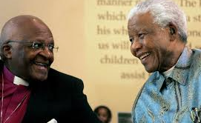
All of our humanity is dependent upon
recognizing the humanity in others.
Archbishop Desmond Tutu
Photo credit: Politico 2021: https://www.politico.com/news/2021/12/26/desmond-tutu-nobel-dies-526149, Accessed 1/19/2026
Notes:
Now more than ever, it is important to remember this quote from Archbishop Desmond Tutu of South Africa who lived through South Africa’s dismantling of Apartheid and governmentally enshrined racism. Our current government should follow Desmond Tutu’s wisdom as well as Nelson Mandela’s, also pictured here.

Slide 4
A case example
KD is a 10-year-old who comes to see you to establish care at a local FQHC. He is accompanied by his mother who speaks Haitian Creole and some Spanish. Through the Haitian Creole interpreter, she shares that she was told that her child needs vaccines to enroll in school.
When asked, she explains that KD was born in Haiti, NSVD and was a “normal size”, spent 1 day in hospital and that since then he has been doing well. The rest of a standard medical and family history are obtained as you establish rapport with the mom and child.
Notes:
Everything that I do, whether in public health work, research, QI, advocacy or policy work is grounded in the patients and families that I see, so let’s start with a case example and I challenge you all, in whatever work that you do, to think about this case and how you approach addressing the mental health, safety and well being of the patients and families that you see.

Slide 5
Koman ou ye?
You ask about her bel timoun, his development over time, schooling access, friends, what he likes to do for fun, favorite foods and his appetite, and if he is sleeping well.
You also explain that it is important to ask questions about their migration to the US to help determine medical testing that is recommended and supports needed. You explain that you will not write anything about legal status in the chart. When asked, the mother states that the child arrived in the US in 1/2025 and that she has been living in the US for the past 8 years after living and working in Chile.
Notes:
1st point—Rapport building—how do you build rapport and trust with any immigrant patient and family that you see? I do it through language and food ☺
2nd point--how to assess mental health of children—are they playing, eating sleeping, going to school and thriving or are there challenges? Toxic stress

Slide 6
You note that the mother makes minimal eye contact when speaking to you and has a blunted affect. When you try to engage the 10 –year- old, he also is not making much eye contact and is very shy, answering questions with wi or non only.
With further questioning, you learn that the child was living with his grandmother in Haiti and his mom was just able to pay for a flight to Mexico for him and his grandmother. They spent several weeks in Mexico and then presented themselves at the US-Mexico border asking for asylum due to ongoing threats to their safety. When asked, the child denies being hurt in Mexico. He then was separated from grandmother, per US policy, and sent to an ORR shelter by himself where he had some vaccines given and medical screening done.
Per US policy, he became an unaccompanied immigrant child
Notes:
What does a “blunted affect” mean?—you feel it yourself—it resonates with you in the room. Minimal animation, moving through molasses, slow, weighted, heavy

Slide 7
4 weeks after separation from his grandmother, he was reunited with his mother who he had only seen over weekly video phone calls since he was 2 –years- old. Grandmother, as a non-legal guardian, was deported back to Haiti. He has been living with his mother for the past 1 month along with his stepfather and 3- and 4- year- old half-siblings, who he just met.
He has yet to start school and he has been out of school for 3 years.
The child has not been eating or sleeping well since arrival and is not engaging with his half-siblings. He denies SI. He recently started wetting the bed at night, something that was not an issue prior to coming to the US.
The child used to like to draw and play soccer but has not been engaging in these activities since leaving Haiti.
When asked, the mom shares that the best way for her to receive health information post-visit is through recorded messages in Haitian Creole and through diagrams and pictures.
Notes:
How often have you heard of cases like this? Sadly, this story is quite common in the US for many children living here; there are many similar stories like this. The degree of stress here—chronic, long-standing, is apparent from fear in Haiti due to abject poverty, violence, family separation, migration to Mexico, no school access, family separation again, and then reuniting with a mother the child has not seen since he was 2 years old except by video calls. He meets a step father and 2 half siblings and has been out of school for 3 years. This is TOXIC STRESS and his reactions to it including new bed wetting at night, decrased sleep, decreased eating and withdrawal/blunting.

Slide 8
Full PE is within normal limits except for noted stress, blunted affect, and signs and symptoms of depression

Slide 9
Some themes from this relatively common case
The need to establish trust and empathy
Refugees, immigrants and multi-generational trauma
Unaccompanied immigrant children
Family separation
Toxic stress
US immigration policies and trauma
Essentials of social history taking—why is this important?
Health system language and learning barriers
Legal status as a social determinant of health
Resilience and strength of immigrant communities
Notes:
Family separation—out of necessity—mom sending money home and pressures to do so; separation of gma/child but US gov’t policies
Social history taking is important to understand a child’s exposure risks to all types of trauma—environmental (lead, arsenic, smoke), assault/abuse/sexually abuse, trafficking; resilience factors; legal status and linkage to legal services

Slide 10
Pediatric Health data, Haiti vs U.S.
Country | Health expenditure, % of GDP, 2021 | Proportion of females with satisfied needs for birth control, %, 2022 | Lifetime physical and/or sexual intimate partner violence, ages 15-49 years, 2018 | Under 5 mortality per 1000 live births, 2022 | Births attended by skilled health workers, %, 2022 | Neonatal mortality per 1000 live births, 2022 | Maternal mortality per 100,000 live births 2023 | Homicide rate per 100,000 population, 2019
Haiti | 3.48 | 45.4 | 23 | 56.87 | 42 (2016-2017) | 23.72 | 327.6 | 20.88
United States | 17.36 | 78.4 | 26 | 6.47 | 99 (2021) | 3.44 | 16.63 | 5.78
In press, Adapted from Young J, et al, Pediatric Clinicians of North America, 2026
Notes:
So, what is Haiti like currently compared to the US—what is the environment this child and family left and what would they face if deported—a real risk to families currently given the fed administration systematic targeting of immigrants in general and revocation of Humanitarian Parolee status. US spends 6 times GDP on health and US GDP is X times larger than Haiti

Slide 11
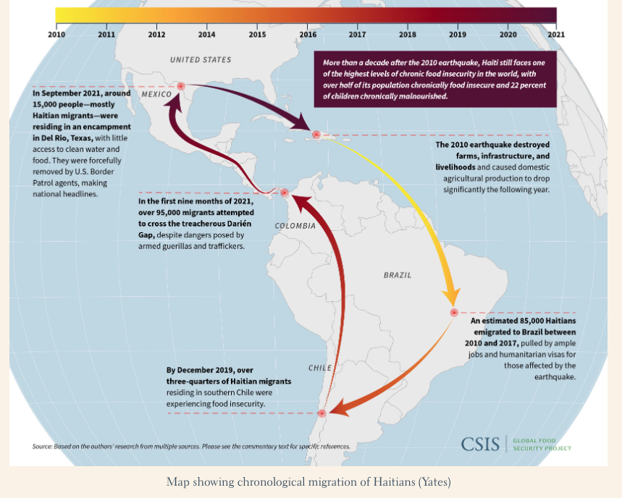
Migration pathways for Haitian people to and from the US
https://storymaps.arcgis.com/stories/c308e7961ae149e78cb8e2b3c31b3b53, Accesssed 1/19/2026
Notes:
And what is the toxic stress of human migration? For Haitians this interactive map gives you an idea.
Cowboys in Texas roping human beings. “All of our humanity is depending on recognizing the humanity in others.”

Slide 12
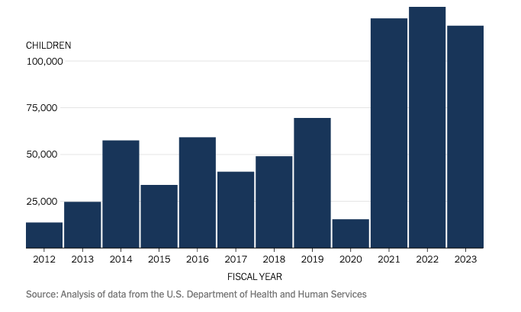
Unaccompanied Immigrant Children Placed by DHHS/ORR with Sponsors in the US, 2012-2023, N=~750,000
https://www.nytimes.com/interactive/2023/12/28/us/migrants-children-data.html, Accessed 1/19/2026
Notes:
The child we are talking about is an unaccompanied immigrant child—these children have experienced excessive and chronic toxic stress. These children live through the US and and hidden in plain site—only identified if you ask them if they were separated from family and in a US Shelter alone. These numbers are staggering and these children are getting no systematic mental health care or other care.

Slide 13
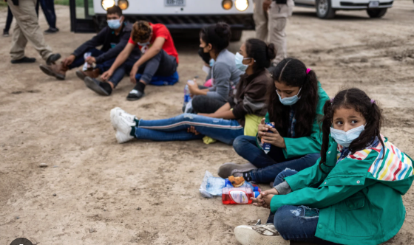
NBC news, 2023 https://www.nbcnews.com/news/investigations/bipartisan-bill-provide-special-courtrooms-migrant-children-rcna119175, Accessed 1/19/2026
Notes:
And here are some photos of children at the US Mexico border, similar to children I saw when I volunteered at At Whiskey 8 in San Ysidro/Mexico border and East in Jacumba

Slide 14
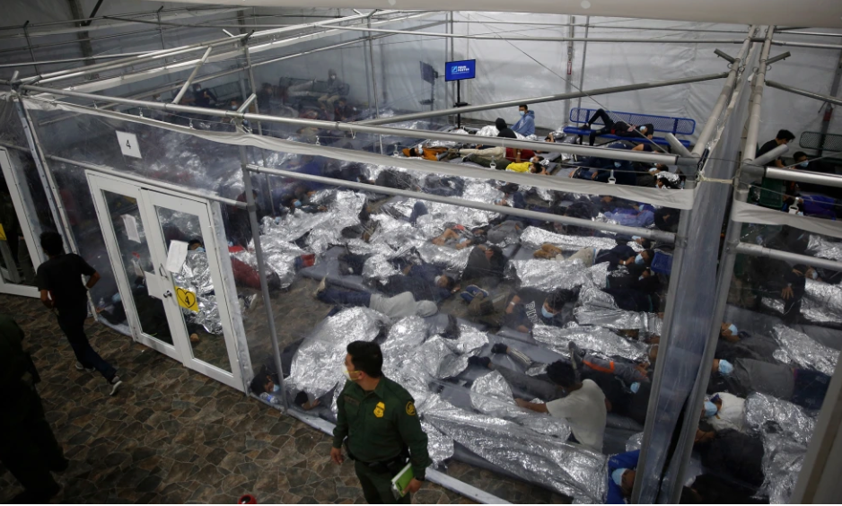
Photo credit, NBC news, 2024
https://www.nbcnews.com/politics/immigration/watchdog-finds-gaps-federal-government-vetted-sponsors-migrant-kids-se-rcna139022, Accessed 1/19/2026
Notes:
This is a photo of unaccompanied children in DHS CBP custody before being sent to ORR Shelters, Donna TX 2021. Toxic stress. This is similar to what I observed when I toured the San Ysidro detention center

Slide 15
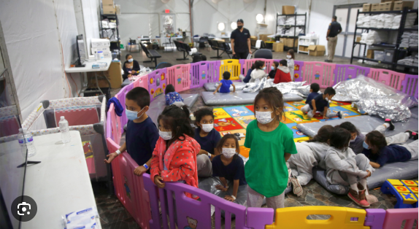
Photo credit: The Hill, 1/21/2023, https://thehill.com/opinion/immigration/3821581-detained-immigrant-minors-deserve-more-than-two-calls-per-week/, Accessed 1/19/2026
Notes:
3-9 yo children either unaccompanied, separated from non legal guardian grandparents, or separated from opposite gendered parents in CBP custody Rio Grand Valley, Donna TX

Slide 16

Toxic Stress in Children
Exposure to chronic adverse events (e.g., child-caregiver separation, poverty, neglect, abuse, environmental instability [natural disasters, gang violence, war, drug trafficking, gun exposure])
Excessive, prolonged, and/or repeated stress exposure→stress response activation
Chronic stress response activation→ Cortisol and other stress hormone production
Chronic egative effects on developing brain/other organ development
Increase HR, BP, and higher risk for developmental delays
Increases risk of development of heart disease, diabetes, depression
https://developingchild.harvard.edu/key-concept/toxic-stress/, Accessed 1/19/2026

Slide 17
Toxic Stress in Children
Symptoms
Behavioral—anxiety, aggression, withdrawal, irritability
Cognitive—poor concentration, decreased memory, problems learning
Physical—somatic complaints, difficulty eating/sleeping
Developmental—emotional dysregulation, regression
Treatment—
Providing support to families—addressing SDoH, providing stable, responsive, supportive relationships to children in home and school environments as early as possible can decrease and even reverse damage from toxic stress
https://developingchild.harvard.edu/key-concept/toxic-stress/, Accessed 1/19/2026

Slide 18
How do you explain your concerns about depression to the mother and that you recommend treatment for both child and mother?
How do you say depression and mental health in Haitian Creole?
Maladi moun (human-caused illness, often supernatural)

Slide 19
Culturally-linked idioms of emotional distress:
Heart—ke (~anxiety and mood disorders)—
Ke sere (constricted heart)
Head—tet (~disorders with psychoses)
Tet chaje (loaded head): kalkile twop (thinking too much)
Symptom-focused treatment
“Without accounting for these idioms of distress, clinical assessment in…mental health at best misses a portion of whatever construct is being measured, and at worse results in the de facto imposition of European and North American notions of psychopathology on populations which may have very different values and healing traditions.”
Rasmussen A et al Transcult Psychiatry 2015; Available at: https://pmc.ncbi.nlm.nih.gov/articles/PMC4312265/#:~:text=In%20Haiti%2C%20ethnographic%20methods%20have,%2C%20&%20Kohrt%2C%202012)., Accessed 1/14/2026

Slide 20
These discussions will take time and extensive trust-building
Use of culturally matched care navigators is key
Discussions with key family members and other trusted people may need to happen, including arranging family meetings
School supports need to be arranged—requests for an IEP evaluation and/or other accommodations in school due to depression/anxiety, PTSD (504 Plan)—letters to program directors at schools are key
Request for Enhanced Care Management/CalAIM https://calaim.dhcs.ca.gov/pages/enhanced-care-management

Slide 21
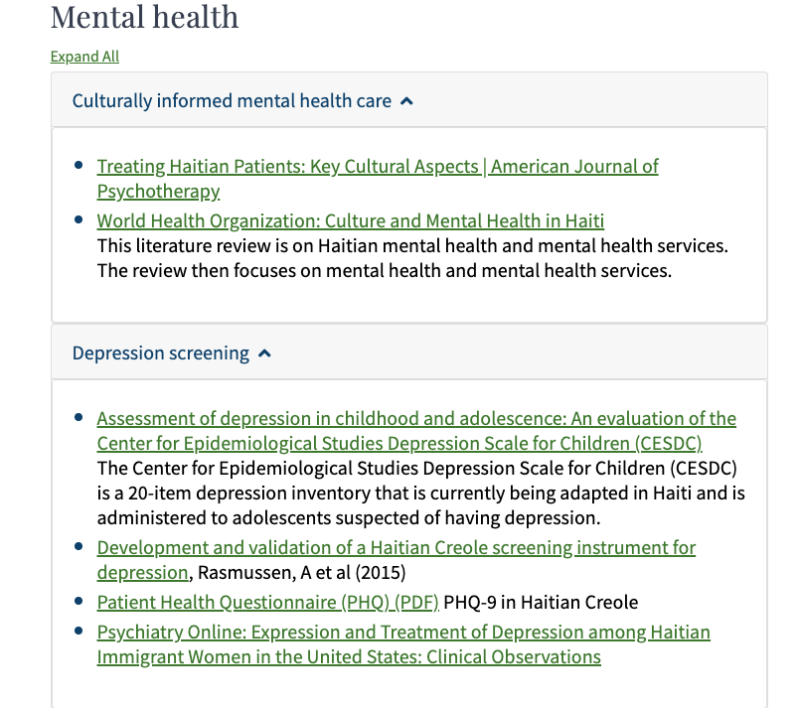

https://www.health.state.mn.us/communities/rih/coe/clinical/haitian.html

Slide 22
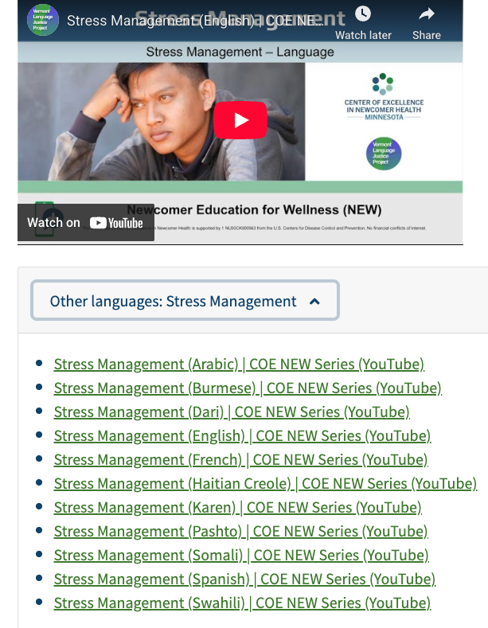
MN Center of Excellence in Newcomer Health
Health Videos
https://www.health.state.mn.us/communities/rih/coe/newvideo/index.html

Slide 23
MN COE in Newcomer Health, Script excerpt
Stress Managment Script
“Today we are talking about stress and how to manage it so that it does not make your brain or body feel sick.
Stress is a part of life for all of us. It can be caused by moving to a new place, thinking about the past, or even worrying about how your children are doing in school, about loved ones back home, or feeling pressure about work and money. Too much stress, however, can make it hard to think, sleep, eat and feel well. Stress can cause sadness, anger, or thinking about a past event over and over again. Your brain can worry so much that your body starts to feel sick too.
Luckily there are ways to manage stress….”
https://www.health.state.mn.us/communities/rih/coe/newvideo/index.html
Notes:
Culturally vetted by 10 different cultural experts and 4 medical experts

Slide 24
Some final thoughts….
We live in very difficult times currently
It is important that we all come together to care for each other and to demonstrate that we all truly believe what Archbishop Desmond Tutu has said—
All of our humanity is dependent upon
recognizing the humanity in others.
I believe that this is KEY to how we find our way forward and this saying informs all the work that I do every day. I live by this and I suggest we all try to do this.

Slide 25

Some ways to get more involved in the care of immigrant communities
https://refugeesociety.org/refugee-health-conference/

Slide 26

https://refugeesociety.org/

Slide 27
Resources
San Diego-specific:
UCSD Refugee and Immigrant Health Unit: https://communityhealth.ucsd.edu/work/refugee-health-unit
San Diego Refugee Communities Coalition: https://sandiegorefugeecommunities.org/
Haitian Bridge Alliance: https://haitianbridgealliance.org/
FQHCs in San Diego: https://funding.hcai.ca.gov/fqhc-site-search/
General resources:
MN COE in Newcomer Health: https://www.health.state.mn.us/communities/rih/coe/index.html
CDC Domestic Refugee Screening Guidelines, mental health section: https://www.cdc.gov/immigrant-refugee-health/hcp/domestic-guidance/mental-health.html
Young, J et al. Health risks of unaccompanied immigrant children in federal custody and in US communities. AJPH 2024: https://ajph.aphapublications.org/doi/full/10.2105/AJPH.2023.307570

Slide 28


