Slide 1


When Pain Speaks a Different Language
When cultural expressions of distress are misunderstood, care can unintentionally deepen the problem!

Slide 2
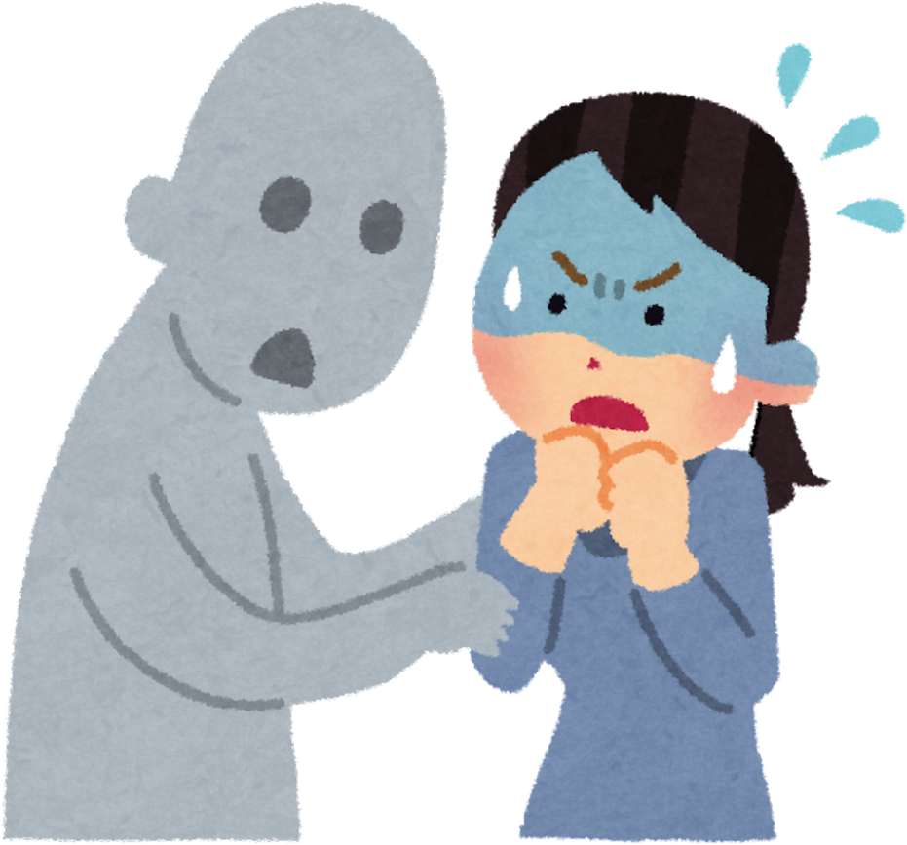
Scenario:
An 18-year-old young woman, newly arrived to the United States , is referred to behavioral health program due to emotional outbursts, self-hitting during distress, and increased aggression. She comes from an immigrant family and is adjusting to a new culture, language, and system while living under strict family expectations.
During the assessment, she explains:
“There is a jinn inside me. When I feel overwhelmed, it tells me to be aggressive and to hurt myself and sometimes others.”

Slide 3

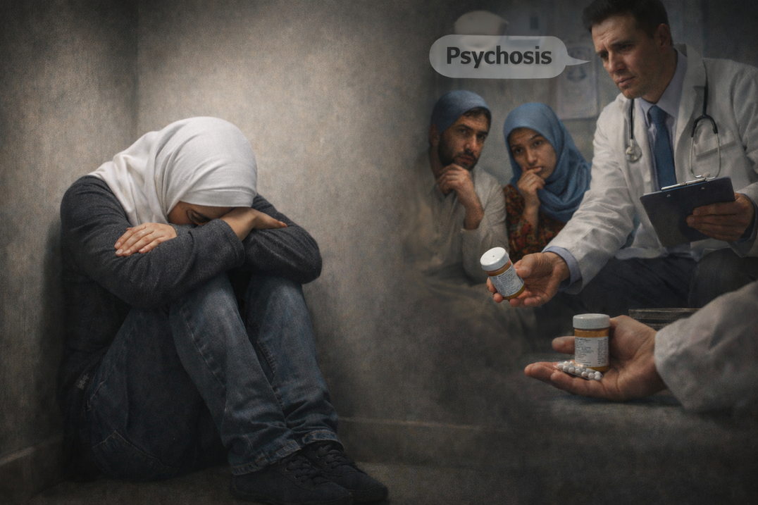

This may be a culturally mediated expression of distress rather than a primary psychotic symptom.
hallucination??
Psychosis???
Schizophrenia???
  Cultural context shapes how stress and mental health challenges are expressed.
  In many of the communities I work with, mental health doesn’t show up as sadness it shows up as anger, silence, and family conflict.

Slide 4
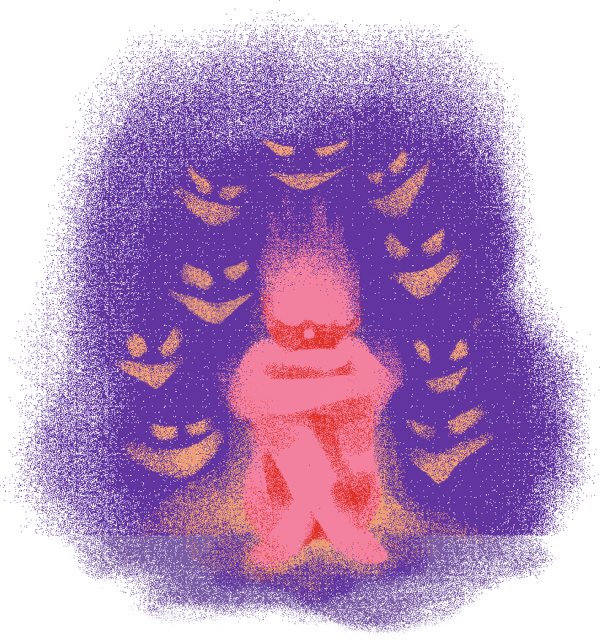
Symptoms are often rooted in:
family relationships, social challenges, spiritual beliefs, and personal or collective values, as well as a sense of living a non‑meaningful life, rather than being expressed as clinical mental health concerns. In some cases, distress is explained through strong cultural or spiritual beliefs, such as the Evil Eye ,jins or other metaphysical causes.

Slide 5
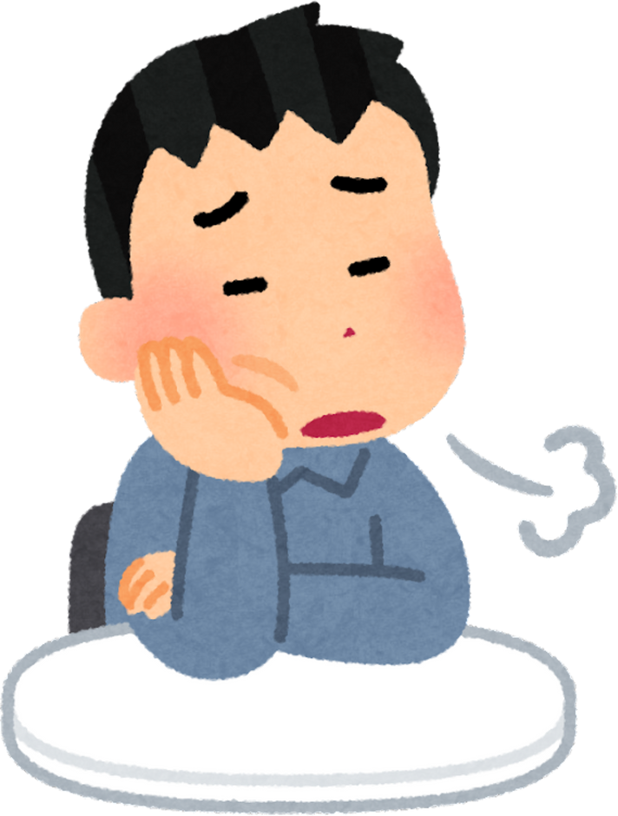
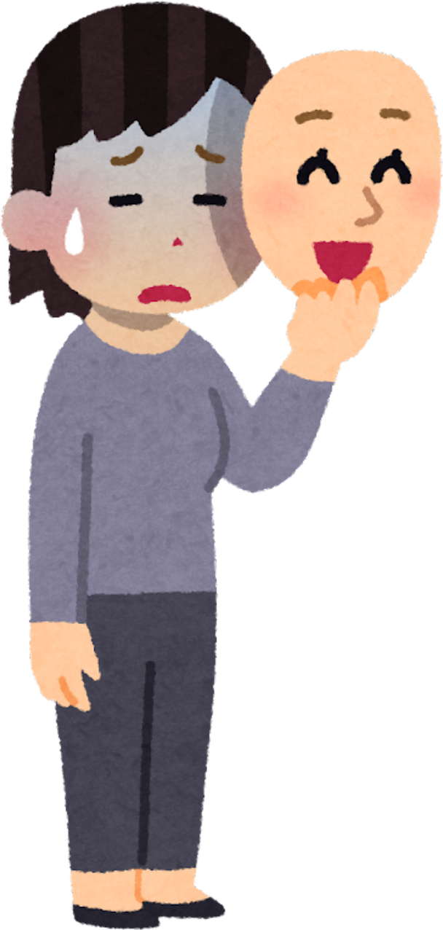
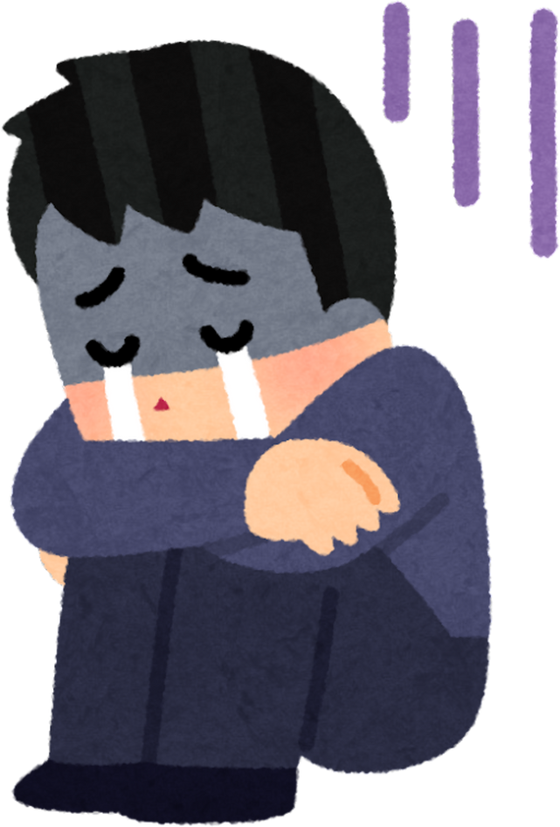
Some Examples:
  Guilt or self-blame
  Hopelessness or lack of purpose
  Social withdrawal or isolation
  Avoidance of responsibilities
  Fears and negative thoughts

Slide 6

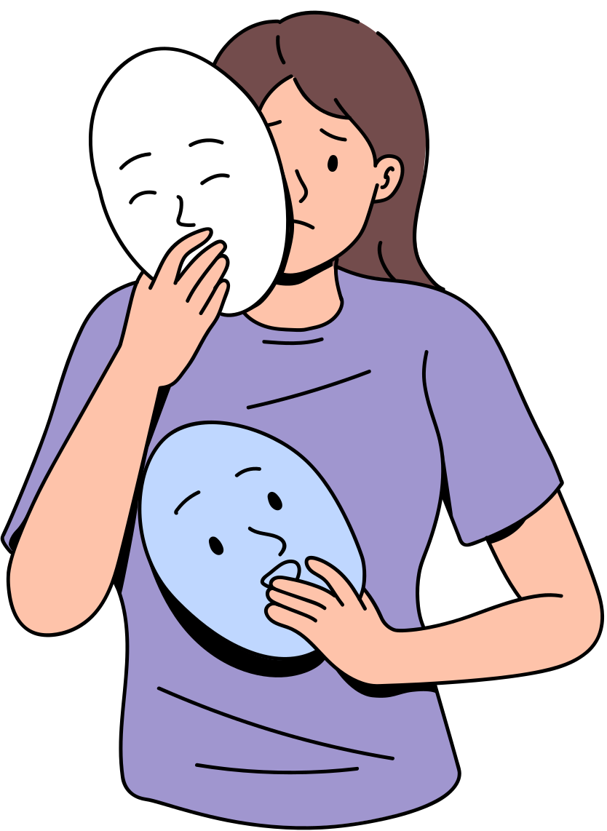


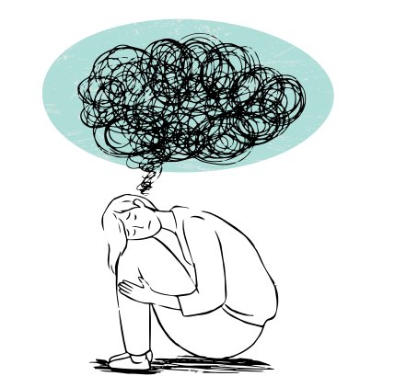

Underlying stressors
Lack of spiritual or familial support (e.g., mother’s prayer)
Pressure from family expectations
Fear of cultural differences and not fitting in
Struggles with personal or collective values
When working with immigrant and refugee individuals and families, it is critical to recognize that trauma often exists deep in the background and may not be immediately visible
Historical trauma

Slide 7

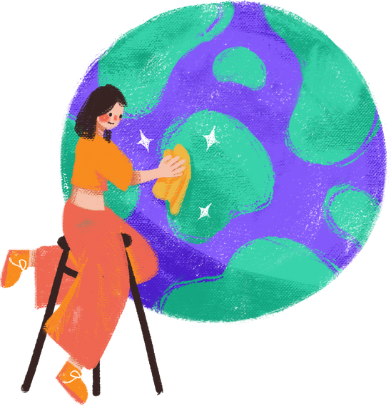
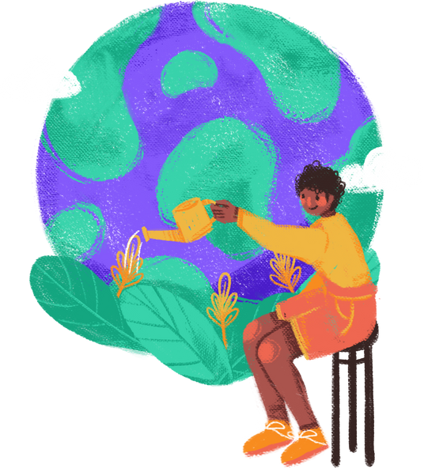
Coping and Healing
  Prayer, faith leaders, spiritual support
  Storytelling, music, art, movement
  Family mediation and community gatherings
  Silence and endurance as learned survival coping
Healing works best when connected to culture, family, and community.

Slide 8
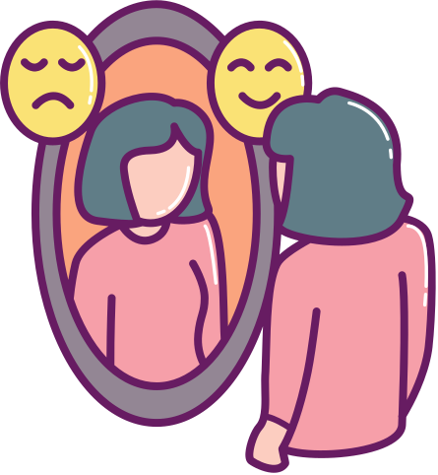
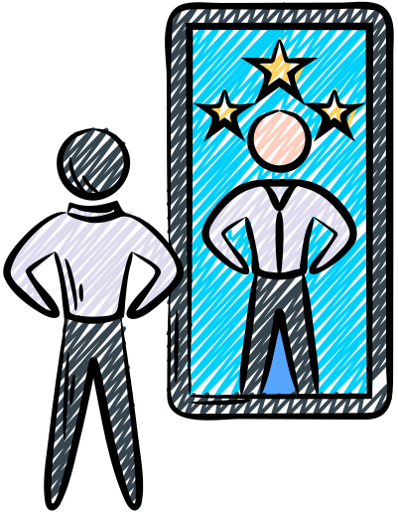
Understanding Our Biases
  Self-awareness is essential to ethical and effective care
  Practice goes beyond clinical knowledge to empathy and human understanding
  Behavioral health providers and staff should regularly reflect on personal values, judgments, and attitudes
  Recognize how implicit biases may influence client engagement, clinical interactions, and treatment outcomes.

Slide 9
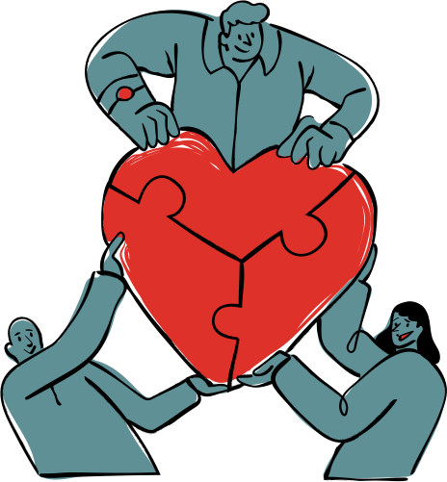

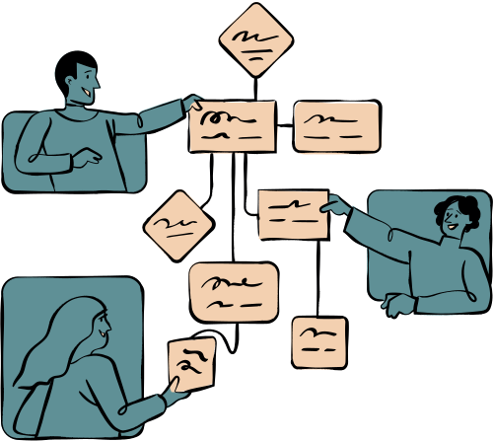
Collaborative Care Model
Effective for individuals with complex or multiple symptoms
Integrates medical treatment with community-based support
Addresses biological, psychological, and social needs
Leads to more sustainable and improved outcomes

Slide 10
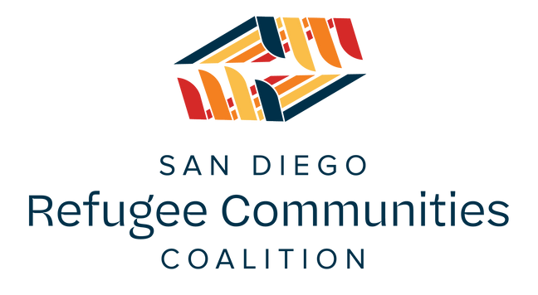
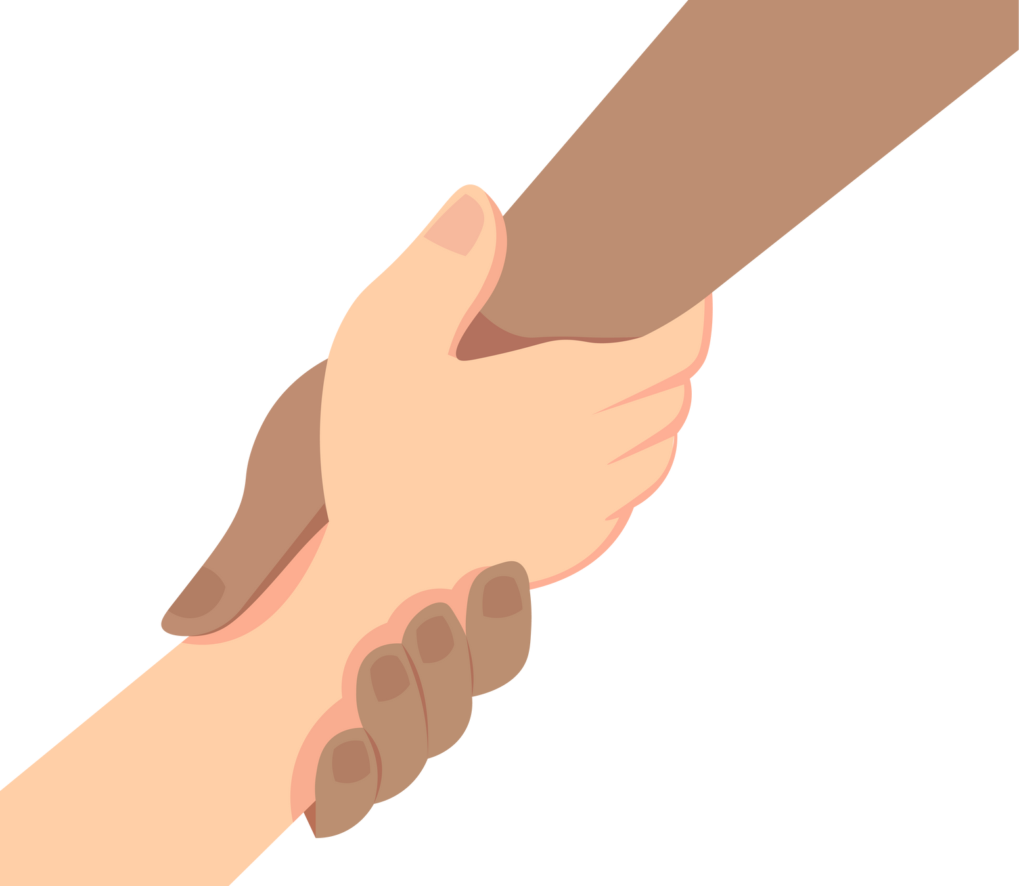
Bridging Behavioral Health and Cultural Care
Under BHI, we provide culturally and linguistically competent services. Each Behavioral Health Specialist (BHS) is selected from the community they serve, and because of this, they already have an innate understanding of the community’s values, challenges, and cultural context. They are trained and equipped to recognize the underlying roots of challenges as well as how these challenges appear through surface-level symptoms.

