Slide 1


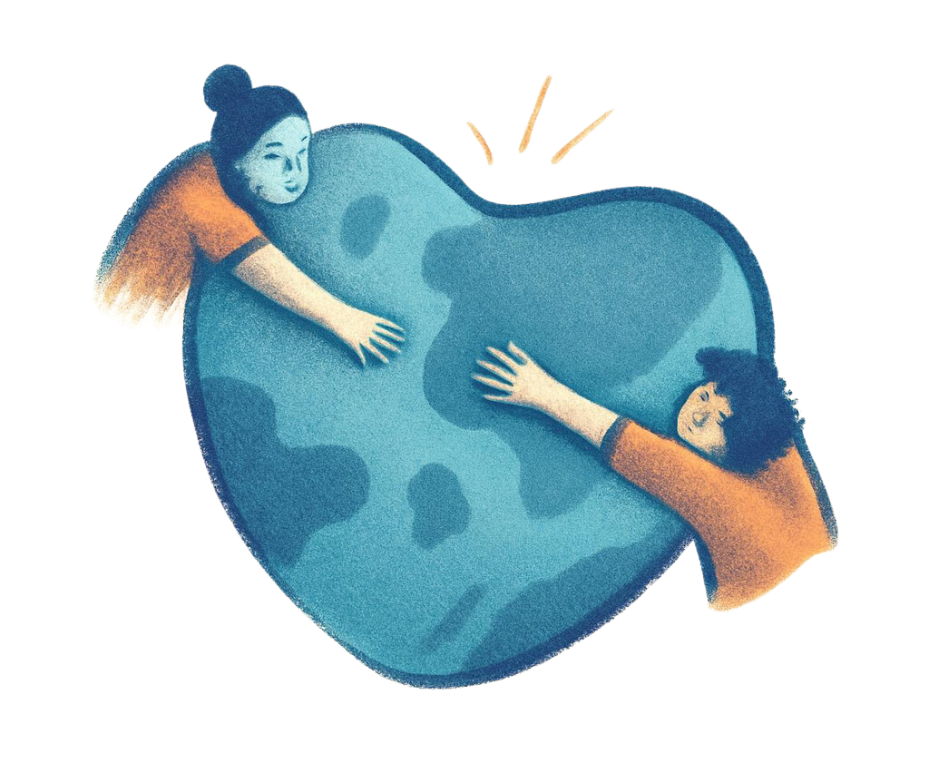




STORIES BEHIND STATUS:
Understanding Refugee Experiences
and Trauma, and Delivering Compassionate Care

Slide 2



PRESENTATION ROAD MAP
KEY LEARNINGS
The political and socio-economic forces that drive individuals to become refugees
How the refugee experience contribute to trauma and emotional distress, and how its being reactivated by the current domestic, political climate
Culturally responsive behavioral health care for immigrant and refugee communities.
GOAL:
To paint a picture of the refugee experience, providing a grounding on how to best approach behavioral health challenges for this vulnerable population

Slide 3





WHAT IS A “REFUGEE”?
A refugee is a specific identification status for individuals forcibly displaced from their home country, for fear of persecution, fleeing to seek safety in another country, defined by international law and granting specific rights and protections.
DRIVERS:
FEAR OF PERSECUTION DUE TO: RACE, RELIGION, NATIONALITY, POLITICAL OPINION, OR DISCRIMINATION BASED ON SOCIAL GROUP OR IDENTITY
PHYSICAL VIOLENCE, TORTURE, INFLICTION OF MENTAL, EMOTIONAL, OR PSYCHOLOGICAL HARM, OTHER DISCRIMINATION OR HARASSMENT, OTHER VIOLATIONS OF HUMAN RIGHTS

Slide 4



TRANSLATING THE REFUGEE EXPERIENCE
LOSS OF HOME AND COMMUNITY
PHYSICAL DANGER AND PROLONGED INSTABILITY
UNCERTAINTY OF WHATS TO COME
RE-TRAUMATIZED BY THE RESETTLING PROCESS

Slide 5

THE TRAUMA PARADIGM
Defintion
Examples
Pre- Flight
Events leading to fleeing home country
Threats to family, harassment, socio-political climate of home country, fear of persecution
Events while waiting for permanent relocation
Flight
Refugee camp living conditions, Human Traffickers, Sexual Abuse
Post- Flight
Status loss, family seperation, isolation and adjustment difficulties (cultural, physical, financial, sociopolitical climate of receiving country)
Resettlement

Slide 6



BARRIERS TO BEHAVIORAL HEALTH CARE
Language and communication
Stigma around mental health
Limited culturally competent providers
Fear of institutions or systems

Slide 7
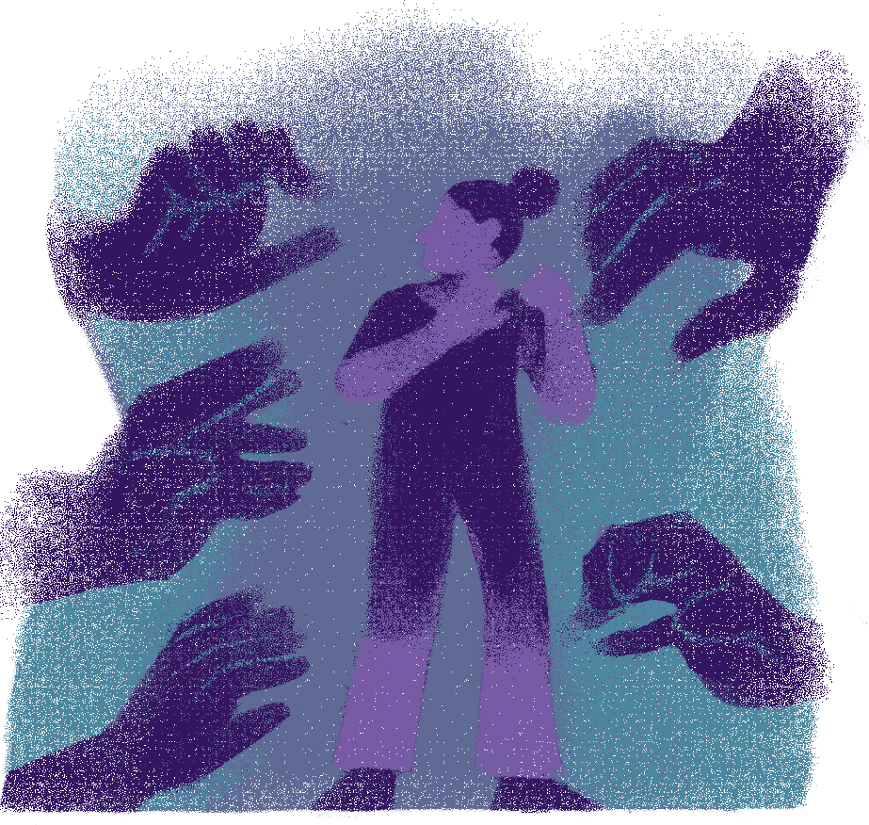

HOW THE CURRENT US POLITICAL CLIMATE IS MAKING IT WORSE
REMOVALS EVEN IF FOLLOWING LEGAL PROCESS OR LEGAL STATUS
HALT OF PROCESSING, INTRODUCING NEW TRAVEL BANS
KIDNAPPINGS OR SELF-DEPORTATIONS
DEPRIVED OF PROPER SUPPORT
STRIPPED OF LEGAL STATUS AND PROTECTIONS
INACCURATE VILLIANIZATION OR “OTHERING”

Slide 8



CULTURALLY RESPONSIVE CARE
CULTURALLY RESPONSIVE CARE INCREASES ENGAGEMENT AND REDUCES STIGMA.
Cultural humility and trust-building, including proper language translations and interpreters
Relevant community partnerships
Trauma-informed approaches
Viewing symptoms through a cultural and migration lens

Slide 9



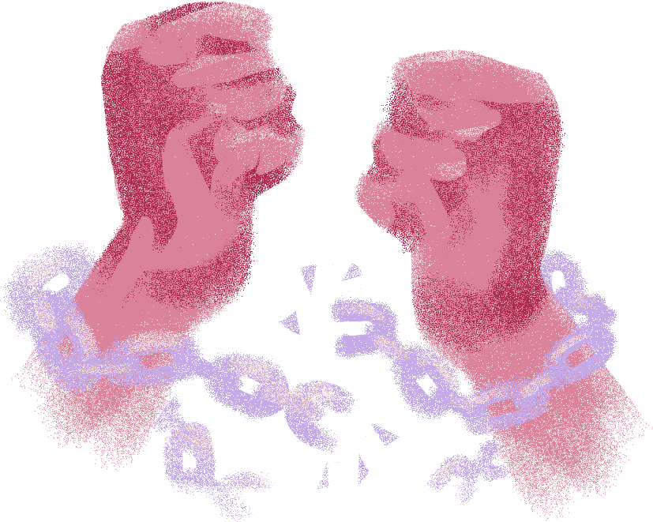

SAN DIEGO REFUGEE COMMUNITIES COALITION (SDRCC) MODELING POSSIBILITY
COLLABORATION OVER COMPETITION
EQUITABLE
A structure that supports equitable access to behavioral health care by Expands access, resources, and supports for immigrant/refugee communities
Collaboration with community-based and culturally specific organizations
Notes:
verbally mention the sdrcc behavioral health (BHI) programmatic focus and amea's grounding in that

Slide 10





AMEA CAMPAIGN
WHAT IT IS
A program that seeks to reduce stigma of mental health and substance use in African, Middle Eastern, and Asian refugee and immigrant communities.
THE APPROACH
The program has a design and advisory committe with one representative from each of the 8 organizations in the SDRCC who is a part of the grant, to provide feedback and assist with designing culturally appropriate workshops, and translate educational materials in 10 languages

