Slide 1
single-session interventions for youth and young adults Jessica l. Schleider, ph.d. Associate professor of medical social sciences, Pediatrics, & psychology Director, lab for scalable mental health Director of digital services, center for behavior intervention technologies northwestern university
www.schleiderlab.org | @JSchleiderPhD | jessica.schleider@northwestern.edu

Slide 2
Faculty Disclosure
Name of Ineligible Company | Nature of Relevant Financial Relationship
Kooth | Sponsored Research Grant
Woebot Health | Consultant
An ineligible company is any entity whose primary business is producing, marketing, selling, re-selling, or distributing healthcare products used by or on patients.
Notes:
|

Slide 3
Meaningful transformation of mental health care
requires reckoning with 3 sobering realities.
Reality 1
~80% of youth and ~50% of adults with mental health needs do not access any form of support.
Reality 2
Supports that do exist are structurally incompatible with how many people (want to) engage with care.
Reality 3
The most common number of interactions with mental health support is one.
Notes:
The gap between need and access to youth mental health treatment is incontestable. Due in part to provider shortages, waiting-lists upwards of 6 to 12 months, and stigma, 80% of U.S. youth who need support access no treatment at all, and existing treatments are often structurally incompatible with how youth engage with (or desire to engage with) care. Supports aren’t located where youth first go to access treatment – and youth are often legally disempowered from engaging with services on their own, especially adolescents, whom in our research repeatedly note that PARENTS are the #1 barriers to accessing care.
Even among youth who do access therapy (which is meant to span weeks or months), the modal number of sessions they typically attend is just one.

Slide 4
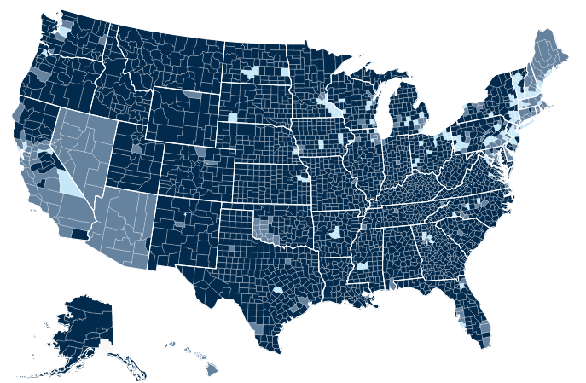
Provider shortages are too severe to fix access-to-care problems
through workforce expansion alone.
Areas in medium and dark blue are formally designated mental healthcare provider shortage areas
Source: data.HRSA.gov
Notes:
Chronic shortages of mental health professionals exist and mental health providers are more likely to practice in urban centers. Very few available providers are trained to provide EBTs to kids.

Slide 5
LAB FOR SCALABLE MENTAL HEALTH
Our Mission:
Design, test, & disseminate brief,
barrier-free interventions to reduce mental health problems at scale
Notes:
-Despite progress in identifying effective youth psychological interventions, up to 80% of youth with mental health needs never access treatment – and even gold-standard treatment is not always effective for those who do.
Given these realities, the goals of our lab are…
These WILL NOT REPLACE intensive interventions for high-need youths – but they may play a role in stepped care models of service delivery, or offer support to the many youths who might otherwise go without services entirely.

Slide 6
What are single-session interventions (SSIs)?
“speciﬁc, structured programs that intentionally involve just one visit or encounter with a clinic, provider, or program”
SSIs may be accessed on one or many occasions (“one at a time”—not “one and done”);
they may be self-guided or human-facilitated;
and they may be accessed within or outside of formal healthcare settings
In all cases, SSIs drop the (often false) assumption that clients will return
and instill the belief that meaningful change is possible at any moment, for any person
(‘context of competence’)
Source: Schleider et al., 2020, Journal of Clinical Child and Adolescent Psychology
Notes:
Strengths based!! Context of competence

Slide 7
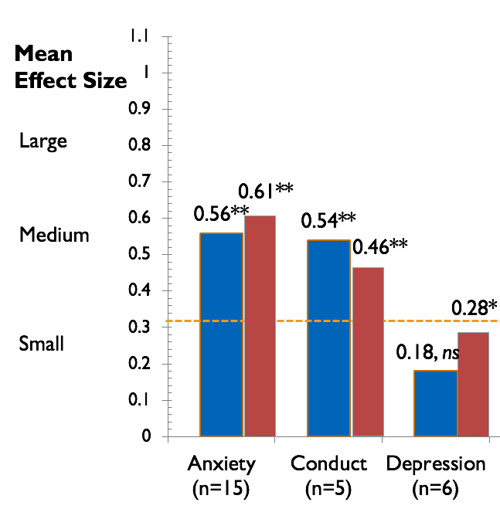
Decades of research tell us that SSIs can help
in some (but not all) cases, as much as longer-term treatments
Red bars: Average effects on mental health symptoms, full-length youth interventions
Weisz et al, 2017, American Psychologist
Blue bars: Average effects on mental health symptoms, single-session youth interventions
Schleider & Weisz, 2017, Journal of the American Academy of Child & Adolescent Psychiatry
*p < .01, **p < .001
Notes:
Precedent = the fact that SSIs can work.

Slide 8
Umbrella Review of Systematic Reviews & Meta-Analyses of SSIs
Schleider et al.,
Annual Review of Clinical Psychology (2025)
24 reviews; 415 clinical trials
Overall SSI benefits reported in 20 of 24 reviews, for both mental health outcomes and service use outcomes
When directly compared to multi-session therapies, multi-session therapies outperformed SSIs
in only 1 of 4 meta-analyses
Overall SSI effect across 12 meta-analyses:
g = -0.25
(95% CI -0.30, -.19), I² = 43.77%
Effects across meta-analyses of mental health SSIs
Hedges g, 95% CI

Slide 9
Single-session interventions will not replace other forms of mental health treatment.
But they can bridge otherwise-unfillable gaps in mental health ecosystems.

Slide 10
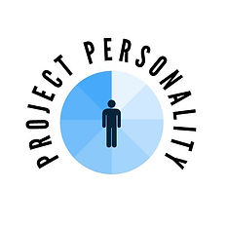
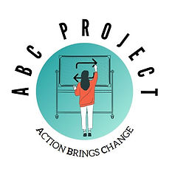
Our lab’s evidence-based single-session interventions
have now served >70,000 youth, young adults, & parents
15,000+ via grant-funded RCTs, 55,000+ via nonprofit and community partnerships, in 9 languages
Two SSIs certified by Blueprints for Healthy Youth Development as “Dissemination-Ready”
Built via co-design with minoritized youth (e.g. LGBTQ+ teens)
40%+ of youth accessing SSIs are racial/ethnic minorities; 75%+ are LGBTQ+ (due to parent consent waivers)
All SSIs are accessible as needed, with or without parent involvement
Single Session Consultation
Each SSI targets a modifiable, short-term belief or behavior
where short-term improvements in perceived control, autonomy, and hope
spur upward spirals of meaningful, long-term change, up to 9 months later
Notes:
…change includes either DECREASES in symptom reductions or INREASES in engagement with other forms of support.

Slide 11
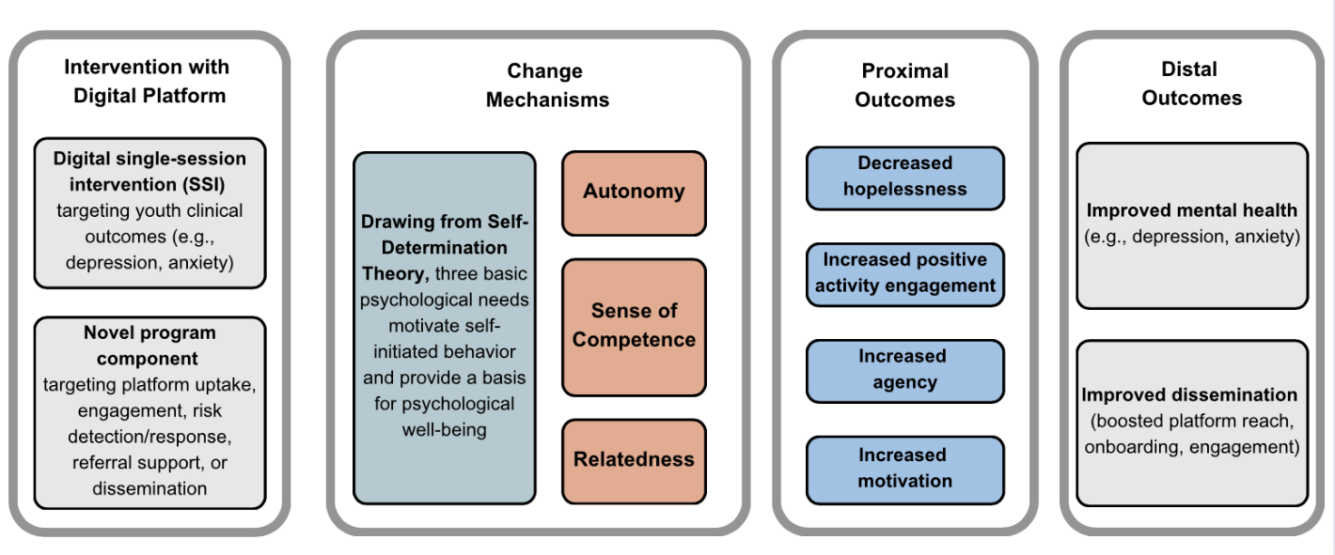
Generalizable SSI Theory of Change
Single-Session Intervention
(may be self-guided or provider-delivered)
Better mental health (depression, anxiety, suicidality)
More engagement in traditional services (outpatient, primary care, school-based)

Slide 12
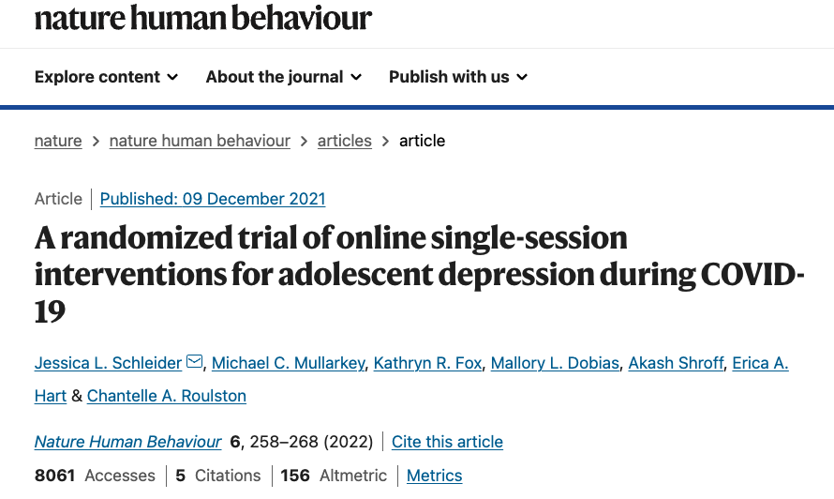
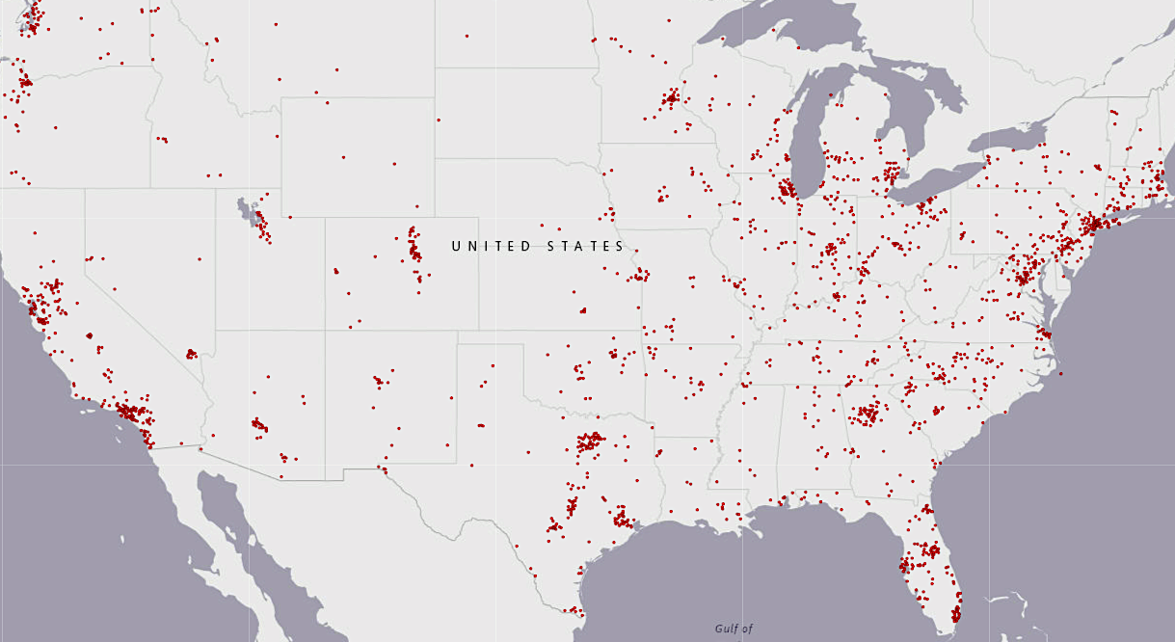
In an NIH-funded RCT (N = 2,452 teens, 80% LGBTQ+, 50% racial/ethnic minoritized youth),
we tested whether two online SSIs (one teaching growth mindset, one teaching behavioral activation)
reduced depression, anxiety, trauma symptoms, and restrictive eating versus a supportive control
Funded by NIH Office of the Director & National Institute of Mental Health
COVID supplement to grant NIH Early Independence Award, DP5OD028123, PI J. Schleider
Notes:
We recruited for this study entirely via Instagram – and critically, we obtained a waiver of parent consent requirements—meaning that teens could self refer into our SSIs and study with or without parent support. This led to a very diverse sample of youth from all 50 states – 80% LGBTQ, 50%

Slide 13
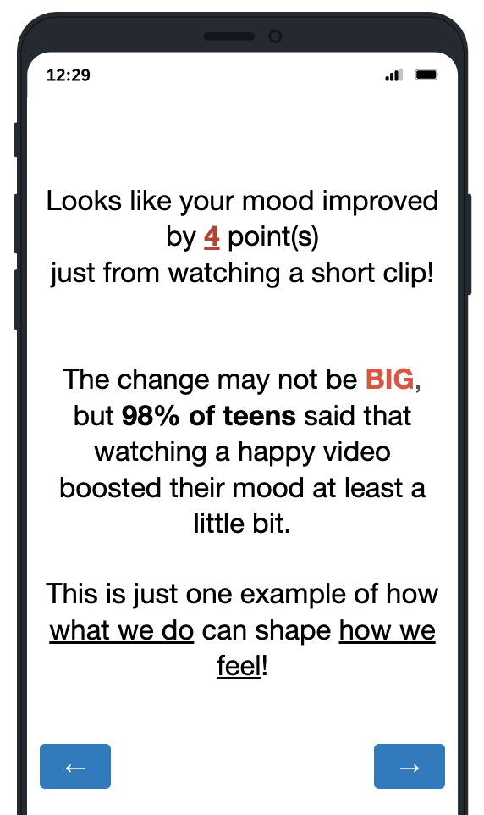
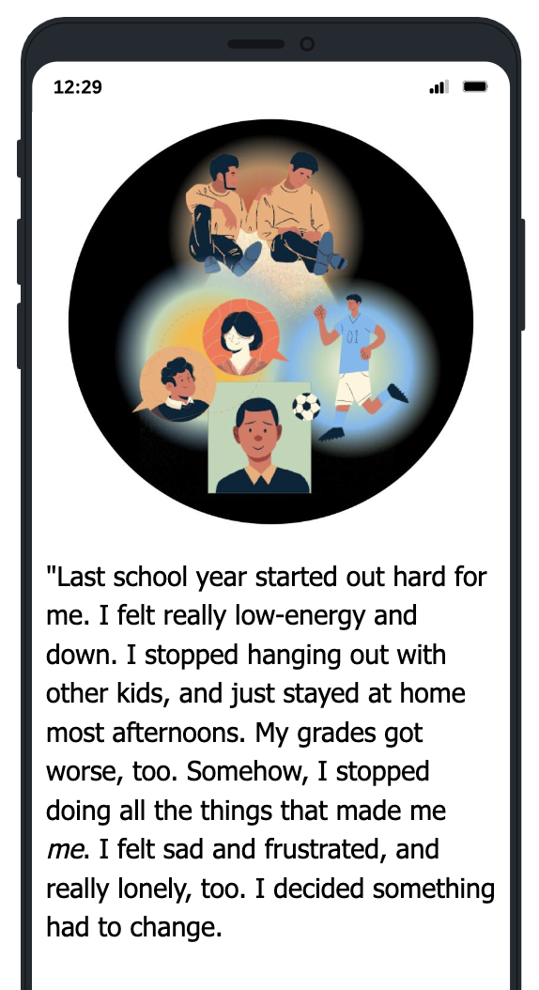
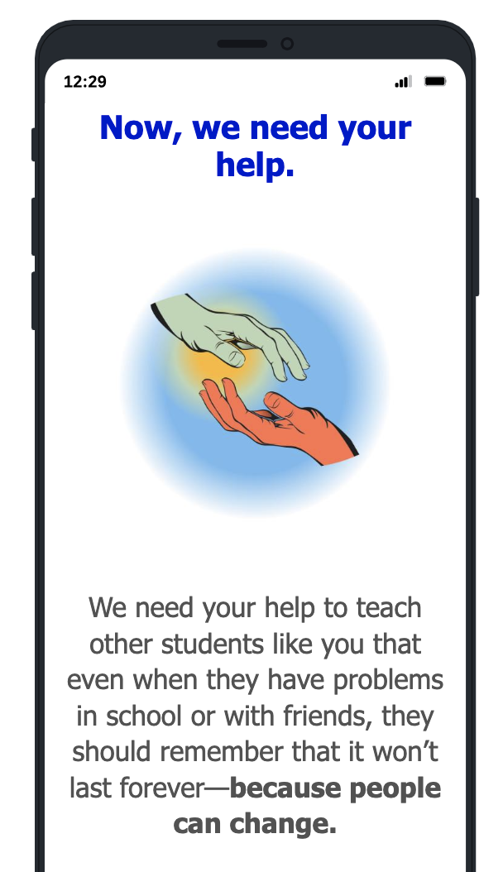
Digital single-session interventions
Brain Science
to boost buy-in
Peer stories
to strengthen relatedness
Action Plan
to streamline skill use
Share advice
to solidify learning
By acting differently, you can build new connections between neurons in your brain.
Your final action plan is:
You will connect with sister, Katy by going on a walk and watching a movie together around Evening, before bed
To do something just for yourself, you will write in journal or diary
If you have your roadblock thought, ‘I can’t do this alone,’ then you can ask mom for help or support
And you can be a good friend to yourself by saying, “I’ve done hard things before, I can do this too”
When neurons form new connections, people can learn to cope with life’s challenges in better ways.
And so, people aren’t stuck being ‘sad’ or ‘shy’; neurons can always form new connections over time. Everyone’s brain is a work in progress.

Slide 14
Control: ‘sharing feelings’ project
Control for non-specific aspects of online SSI
Aims to normalize and encourage sharing feelings with close others
Resembles advice kids often receive
Face-valid; doesn’t “give away” intervention condition
No mention of malleability of personal traits or abilities; no action plan
No opportunity to give advice to others

Slide 15
Effects on hopelessness & agency(immediate post-intervention)
Outcome | Cohen’s d [95% CI]
 | Baseline to post-intervention
Hopelessness (ABC vs. Placebo) | .26 [0.16, 0.36], p_{adj} < 0.001
Hopelessness (Personality vs. Placebo) | .28 [0.18, 0.38], p_{adj} < 0.001
Perceived Agency (ABC vs. Placebo) | .31 [0.21, 0.40], p_{adj} < 0.001
Perceived Agency (Personality vs. Placebo) | .15 [0.08, 0.28], p_{adj} < 0.001
Project ABC = Behavioral Activation SSI
Project Personality = Growth Mindset SSI
Notes:
Positive effect sizes indicate greater improvement in the intervention condition versus the control from baseline to follow-up; significant effects shown in green

Slide 16
Effects on clinical outcomes (3 months)
Neither acceptability nor effectiveness differed by race, ethnicity, gender, or sexual orientation (McDanal et al, 2024, Clinical Psychological Science)
Outcome | Cohen’s d [95% CI]
 | Baseline to 3 months
Depression symptoms (ABC vs. Placebo) | .18 [0.08, 0.28], p_{adj} < 0.001
Depression symptoms (Personality vs. Placebo) | .18 [0.08, 0.27], p_{adj} < 0.001
Anxiety symptoms (ABC vs. Placebo) | .02 [-0.08, 0.12], p = 0.72
Anxiety symptoms (Personality vs Placebo) | .10 [.006, .20], p = 0.038
COVID-related trauma (ABC vs. Placebo) | .10 [-.001, .19], p = 0.057
COVID-related trauma (Personality vs Placebo) | .10 [.006, .20], p = 0.037
Restrictive eating (ABC vs Placebo) | .15 [.06, .25], p = 0.002
Restrictive eating (Personality vs Placebo) | .10 [.002, .20], p = 0.044
Project ABC = Behavioral Activation SSI
Project Personality = Growth Mindset SSI
Notes:
Positive effect sizes indicate greater improvement in the intervention condition versus the control from baseline to follow-up; significant effects shown in green
**Promising for such a brief program (esp. b/c previous SSIs had limited effects on depressive symptoms), and suggests a brief, potentially scalable approach to helping reduce anxiety and depression in high-symptom youth. Towards the end of this talk, I will preview future directions for this work – for instance, testing the mindset intervention’s effectiveness with clinically depressed and clinically anxious adolescents, both as a stand-alone intervention and as an adjunct to full-length cognitive-behavioral therapy.

Slide 17
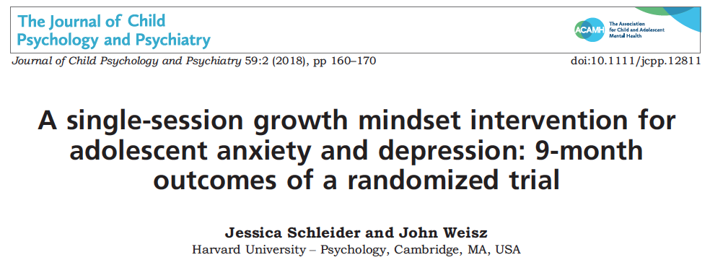
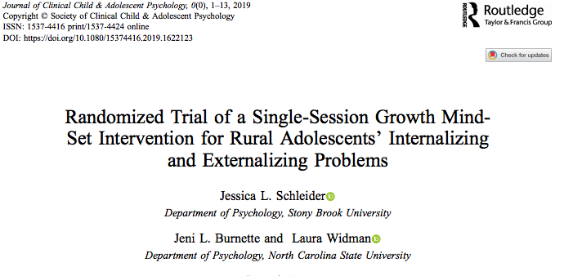
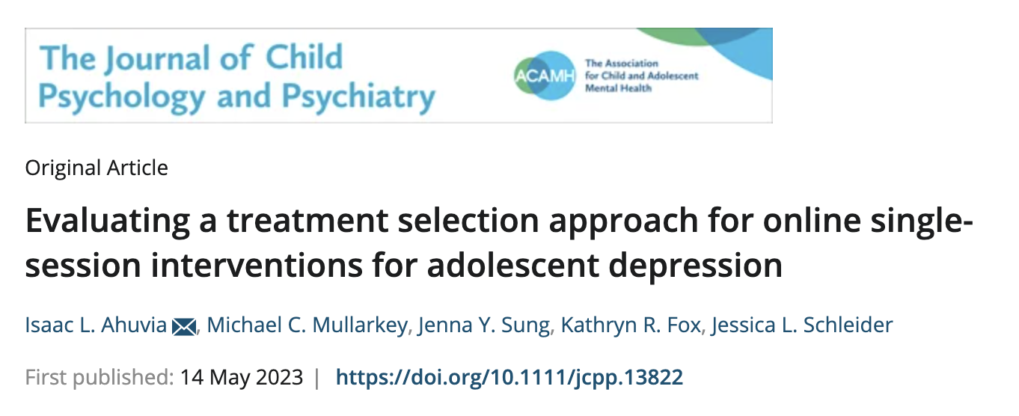
Do online SSIs for depression work better for certain groups than others?
Other things that haven’t influenced SSI response:
Baseline symptom severity
Presence of SITBs
Parent psychopathology
Receipt of concurrent treatment (meds, therapy, or both)
Notes:
Same patterns observed in meta-analysis from 2017 – replicated in all of our studies….
NOTE – bl symptom severity does predict odds of UPTAKE of SSIs in naturalistic settings!!

Slide 18
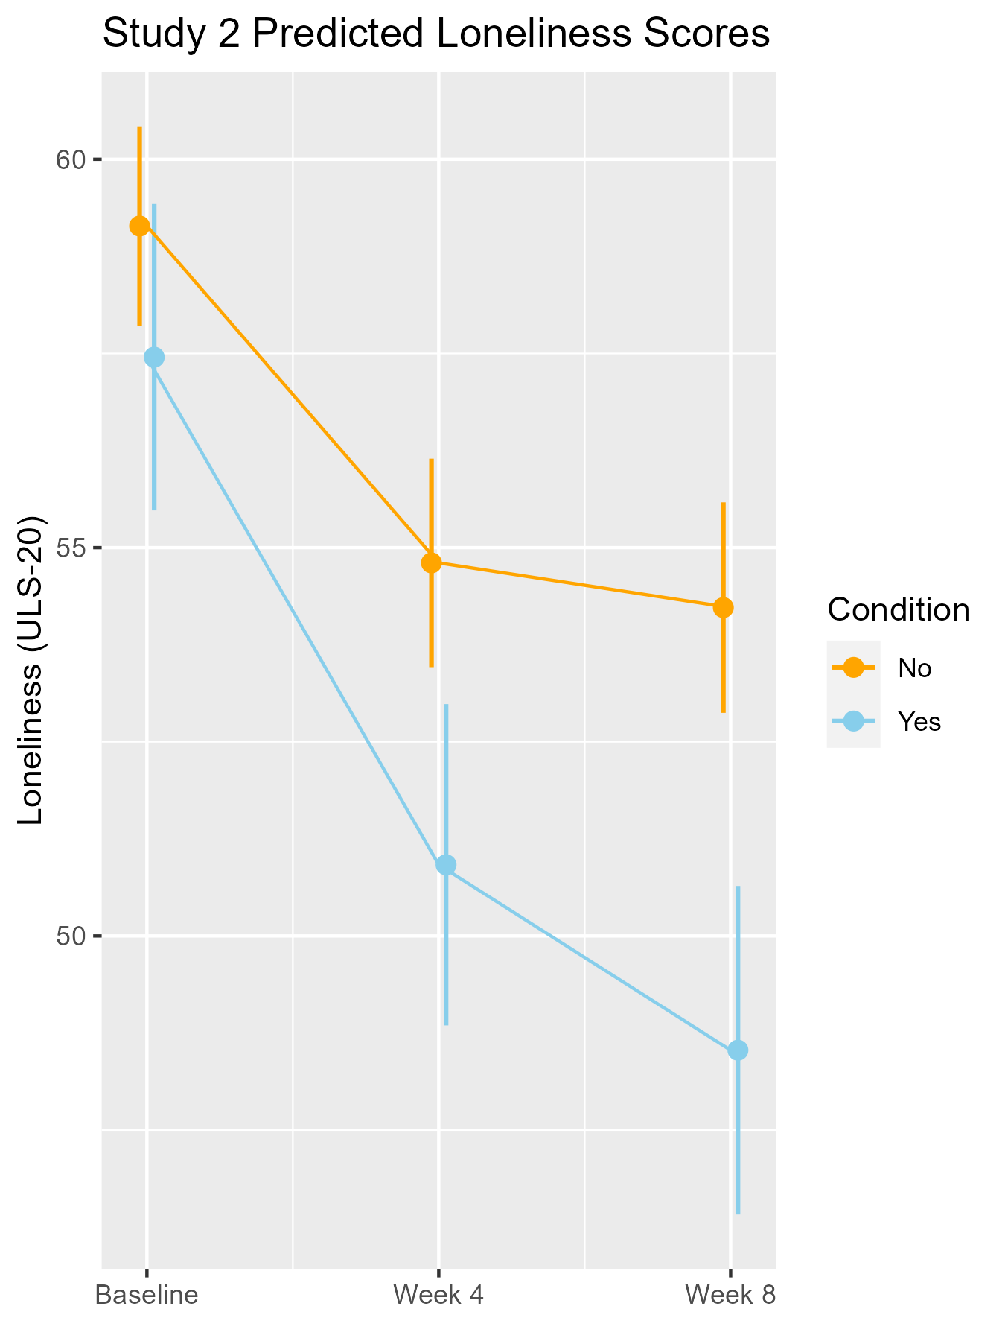
Do “Aha! moments” help explain SSI response?
Sung, Kaveladze, Sotomayor, Liao, & Schleider, under review
In an RCT of an 8-min SSI focused on loneliness (N = 424 young adults with elevated depression), vs. a placebo SSI…
41.2% had an Aha! moment during the 8-minute loneliness SSI
22% had an Aha! moment in the control SSI
Aha!
Notes:
When it comes to depression SSIs and “precision treatment,”
maybe key questions aren’t which or for whom…
but rather, where and how?
Precision SSI dissemination?

Slide 19
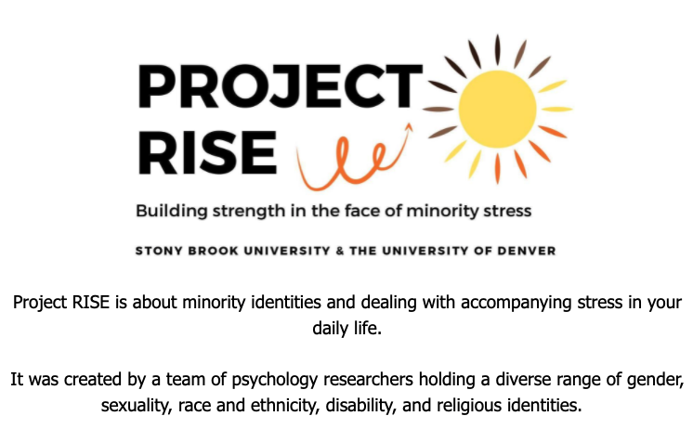
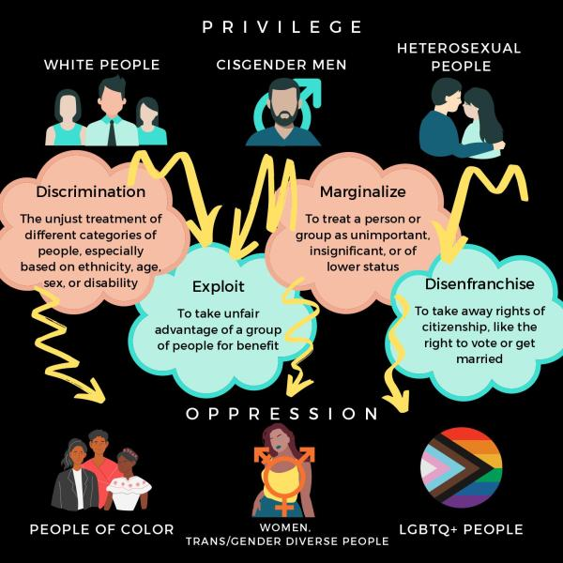
Co-designing with LGBTQ+ teens for ssi effectiveness Shen, Rubin, Cohen, Hart, sung, mcdanal, Roulston, fox, & Schleider, internet interventions, 2023
Sample: 538 LGBTQ+ youth, ages 13-16
Recruited via Instagram; obtained parent consent waiver
Project RISE significantly improved hopelessness, self-hate, internalized stigma vs. info-only control

Slide 20
empowering parents & caregivers for ssi effectiveness sung, mumper, & Schleider, jmir mental health, 2021 Sung & Schleider, under review
vs. an information-only control…
Studies 1 & 2: Does EMPOWER reduce parent accommodation?
Study 1: Does EMPOWER improve parent distress tolerance?
Study 2: Does EMPOWER reduce child anxiety?

Slide 21
RCT 1 (2021): 301 high-anxiety parents
vs. an information-only control…
Did EMPOWER reduce parent accommodation?
Did EMPOWER boost parent distress tolerance?
Project EMPOWER significantly reduced parent accommodation of child anxiety
over two weeks, versus information-only
d = 0.61 [95% CI 0.38, 0.84]
Project EMPOWER significantly improved parent distress tolerance
over two weeks, versus information-only
d = 0.43 [95% CI 0.20, 0.66]

Slide 22
RCT 2 (Sung & Schleider, under review): 137 parents experiencing financial insecurity
vs. an information-only control…
Did EMPOWER reduce parent accommodation?
Did EMPOWER reduce child anxiety symptoms?
Project EMPOWER significantly reduced parent accommodation of child anxiety
over four weeks, versus information-only
d = 0.18, p < .001
Project EMPOWER significantly improved child anxiety symptoms
over four weeks, versus information-only
d = 1.36, p < .001
What next?
Embedding EMPOWER on waiting-lists and in primary care

Slide 23
Primary care integration
Social media integration
Government partnership
Industry partnership (commercialization, SBIR)
SCALING UP SSIs:
testing strategies across systems
Co-design with youth
Free, anonymous websites
Support for patients on waitlists
Drop-in SSI center
Results are revealing where and how SSIs can bridge gaps in care,
and what barriers get in the way

Slide 24
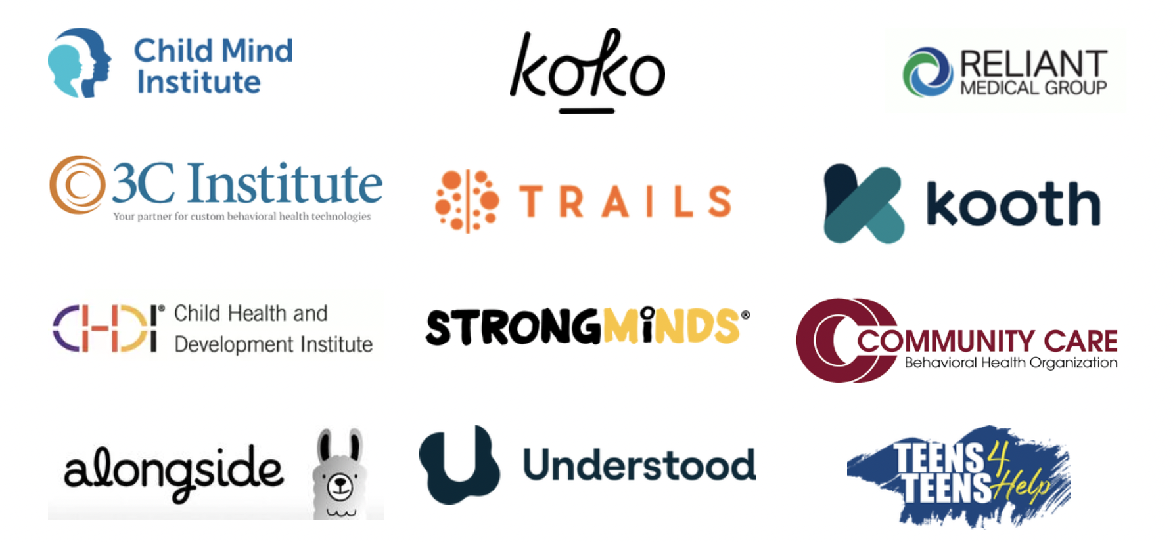
multi-sector partnerships (nonprofit, industry, & advocacy groups) to streamline ssi implementation

Slide 25
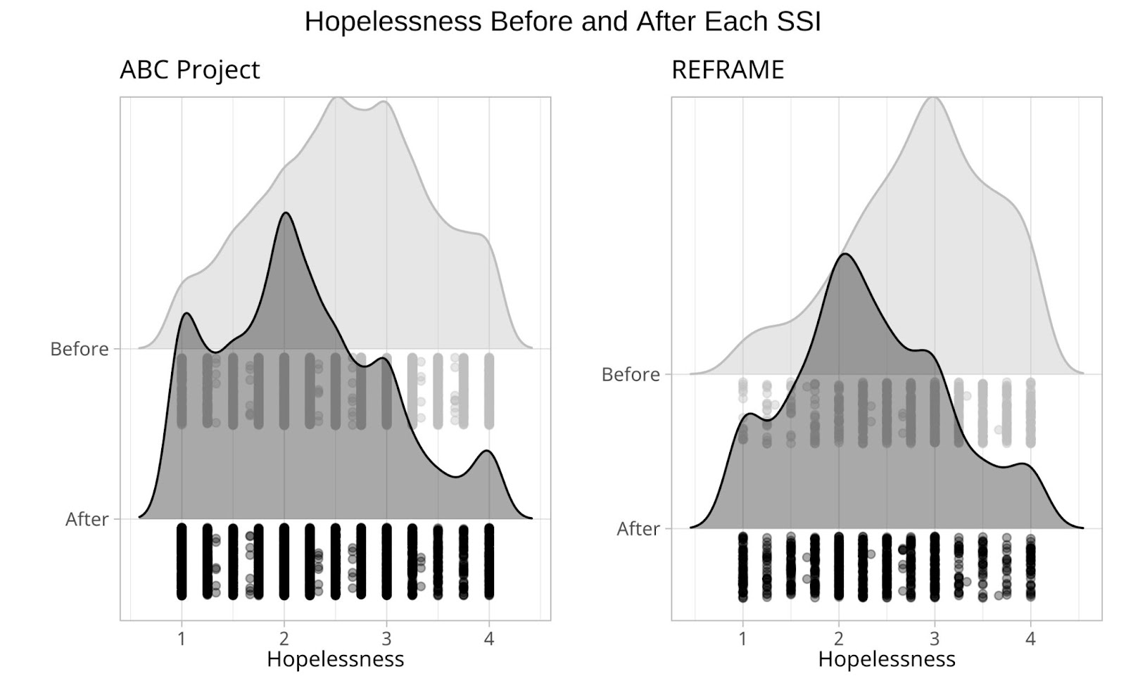
social media integration for ssi dissemination Dobias, Morris, & Schleider, jmir formative research, 2022
SSIs embedded into Tumblr as ’just-in-time’ supports, based on on search patterns
SSI length was reduced from ~25 to ~6 minutes, with core elements retained
SSIs were completed by 6,179 teens within one year
Hopelessness reduced at least as much in Tumblr-based SSIs as in our RCTs
…But completion rates increased by 50% vs. prior naturalistic dissemination efforts

Slide 26
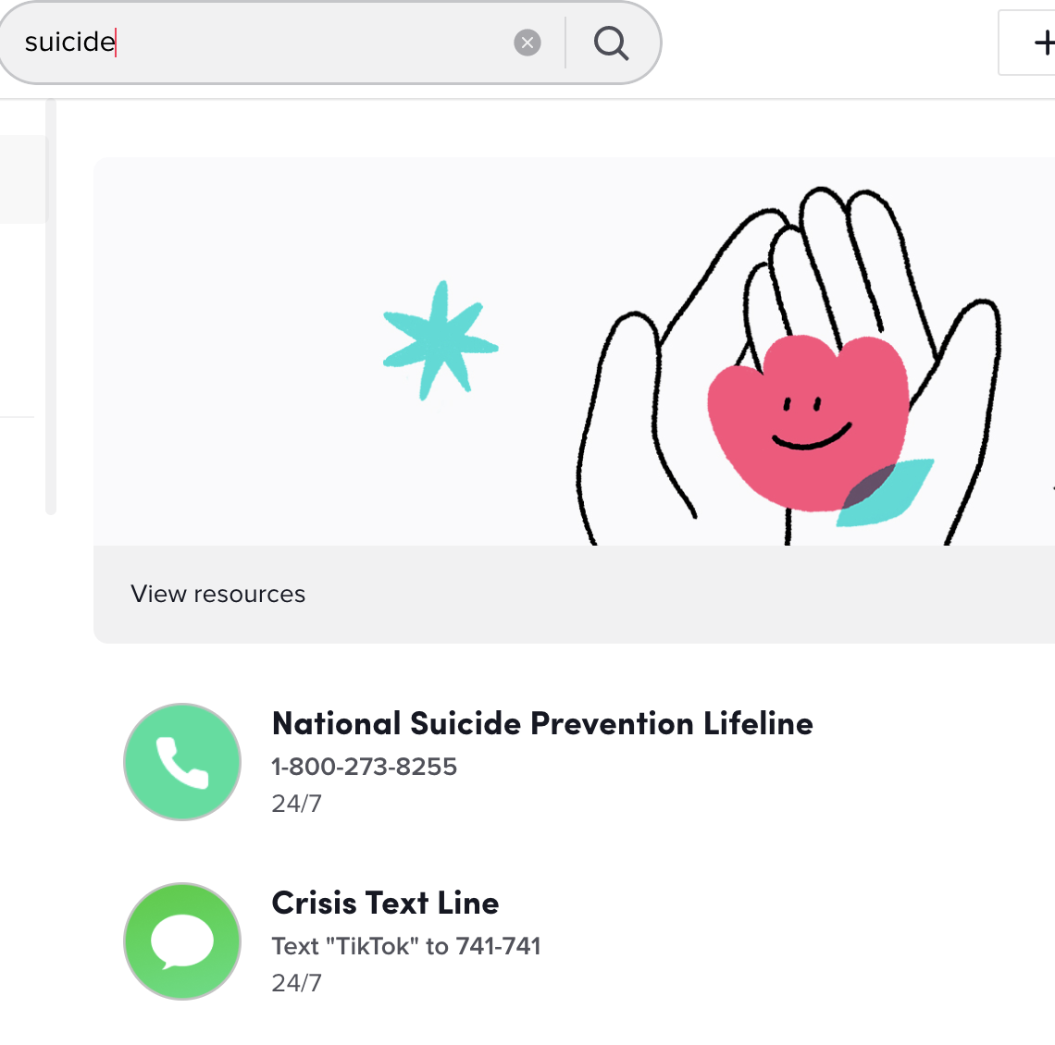
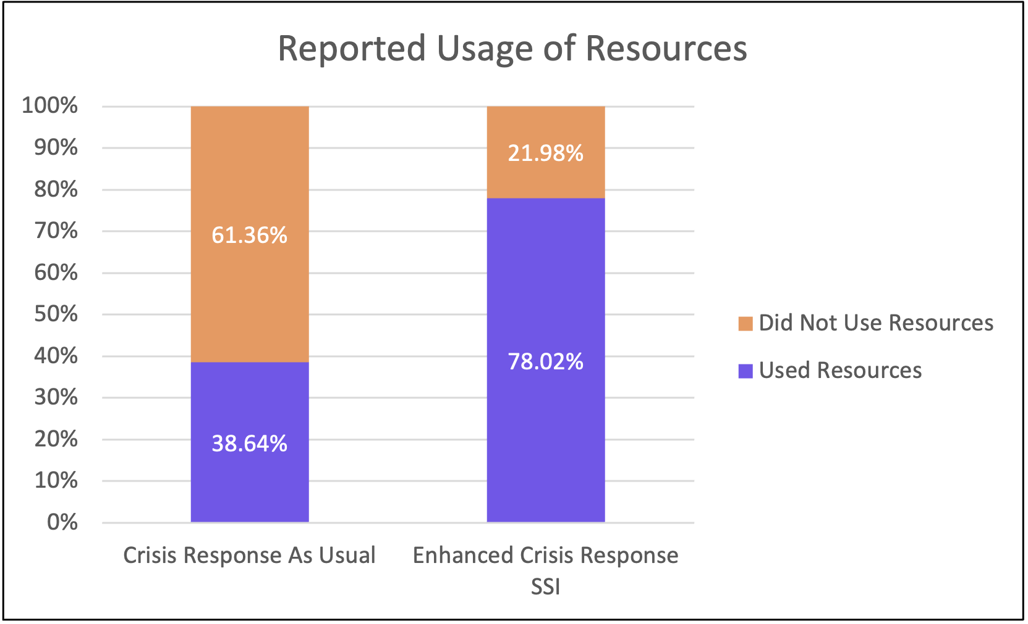
Leveraging an ssi to boost crisis resource uptake cohen, dobias, morris, & Schleider, 2023, journal of cognitive & behavioral therapies
Social media users flagged as “in crisis” often receive text-lines/hotlines automatically (via AI).
But many people in crisis don’t use them.
A one-minute SSI doubled in-the-moment uptake of online crisis resources, following AI-based risk detection
N = 355 young people recruited via social media platforms

Slide 27
Co-designing and implementing a digital ssi platform for youth mental health
Our Goal
Deliver effective, just-in-time digital SSIs to youth with unmet mental health needs
while bridging the gap between online and community-based support
Web-based platform of evidence-based, self-guided SSIs
offered ‘just in time’ to youth via social media, schools, and primary care
Referrals to existing, local, community-based resources
for youth who want more support

Slide 28
Co-designing and implementing a digital ssi platform for youth mental health
Digital SSI Platform Features
-Easy onboarding (no app download; laptop/phone compatible) and optimized user interface
-Mental health self-screening
-AI-powered risk detection
-Instantly receive evidence-based digital SSI, tailored for primary problem
-Suite of additional SSIs available 24/7
-Instant connection to local services (in schools, primary care, or outpatient clinics)
How does the platform help?
-Eliminates wait-times for evidence-based mental health support, 24/7
-Alleviates distress due to common mental health problems, both in the short and long term
-Increases connection with existing community services, for youth who need/want more support
-Boosts receptivity and hope that mental health treatment can help
-Bridges the gap between need and support, for youth who might otherwise fall through the cracks

Slide 29
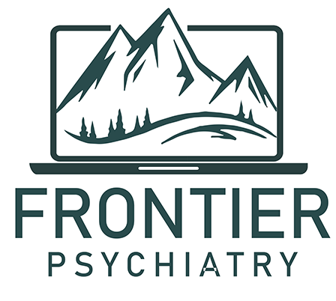
Scaling-up A digital single session intervention platform for youth mental health
Create a digital, self-guided, user-friendly SSI platform that is ready to scale in schools, primary care, and online
1
Culturally adapt and co-design SSI platform components to meet the needs diverse youth
2
Create a dissemination toolkit for mental health providers, primary care staff, & school staff to deploy the SSI platform to youth in their setting
3
Deploy & evaluate the impact of the dissemination toolkit on the SSI platform’s reach, acceptability and effectiveness
4
Funders: Twilio, Montana DPHHS/HRSA, private donors, Jacobs Foundation, TRAILS. Pending: SCDMH grant, NIMH R01, GA state behavioral health budget (per formal recommendation by Behavioral Health Reform and Innovation Commission – TBD until GA Gen. Assembly session)
Funded/ongoing work
Pending funding
Notes:
We’ll know the outcome at the conclusion of the next Session of the GA General Assembly -- around the end of March

Slide 30
Supporting people on wait-lists for SSI disseminatioN SCHLEIDER, SUNG, BIANCO, GONZALEZ, VIVIAN, & MULLARKEY, 2021 SUNG, BUGATTI, VIVIAN, & SCHLEIDER, 2023 kasujja, szkody, Sotomayor, birunji, & Schleider (in prep)
Single-Session Consultation (SSC)
Can a therapist-delivered, Solution-Focused Brief Therapy SSI
reduce hopelessness, increase agency, and prevent symptoms from worsening in clients on therapy waiting lists?
Establish shared purpose for being here
Identify client’s top problem
Identify client’s top hope
Pose the miracle question
Create scale based on miracle question
Explore exceptions to the problem
Make an action plan
Write your client a note of confidence
Provider training lasts
90 minutes total
SSC itself lasts
30 – 60 minutes total

Slide 31
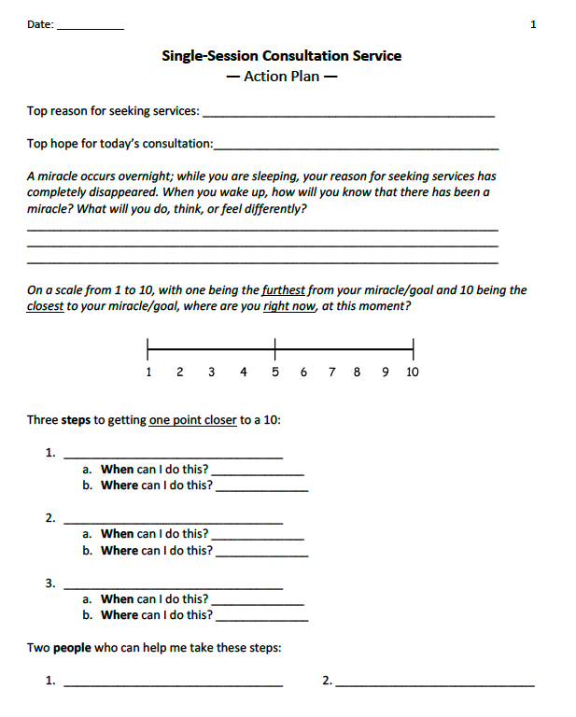
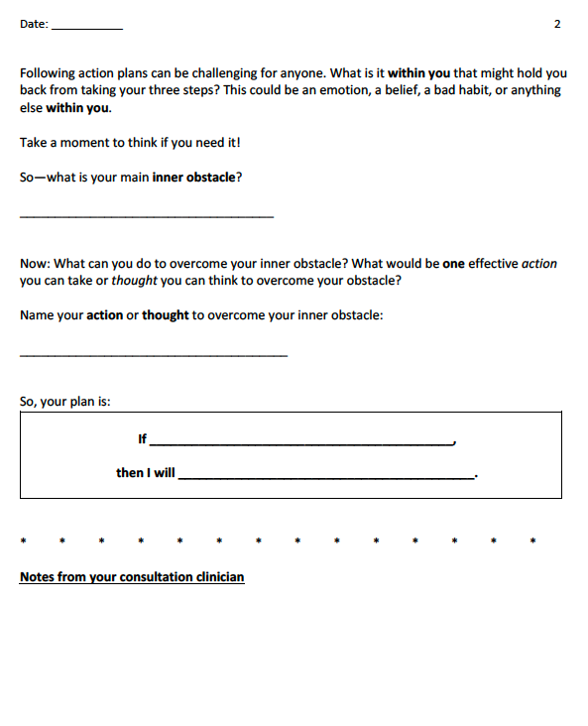

Slide 32
Supporting patients on wait-lists for SSI disseminatioN SUNG, BUGATTI, VIVIAN, & SCHLEIDER, 2023
Single-Session Consultation (SSC)
N = 65 clients on waiting lists received SSC via teletherapy
Hopelessness showed an 85.18% chance of decreasing (p < .001, d = 1.04)
Readiness for change showed an 80.87% chance of increasing (p < .001, d = 0.83)
Anxiety decreased (d = .32) and depression decreased (d = .20) 2 weeks later
(increases in symptoms while waiting for care are the norm!)
Notes:
Common language effect sizes
Now continuing to provide the SSC as an option to all clients at our psychology clinic via teletherapy!
US, UK, Australia, Canada, Ukraine

Slide 33
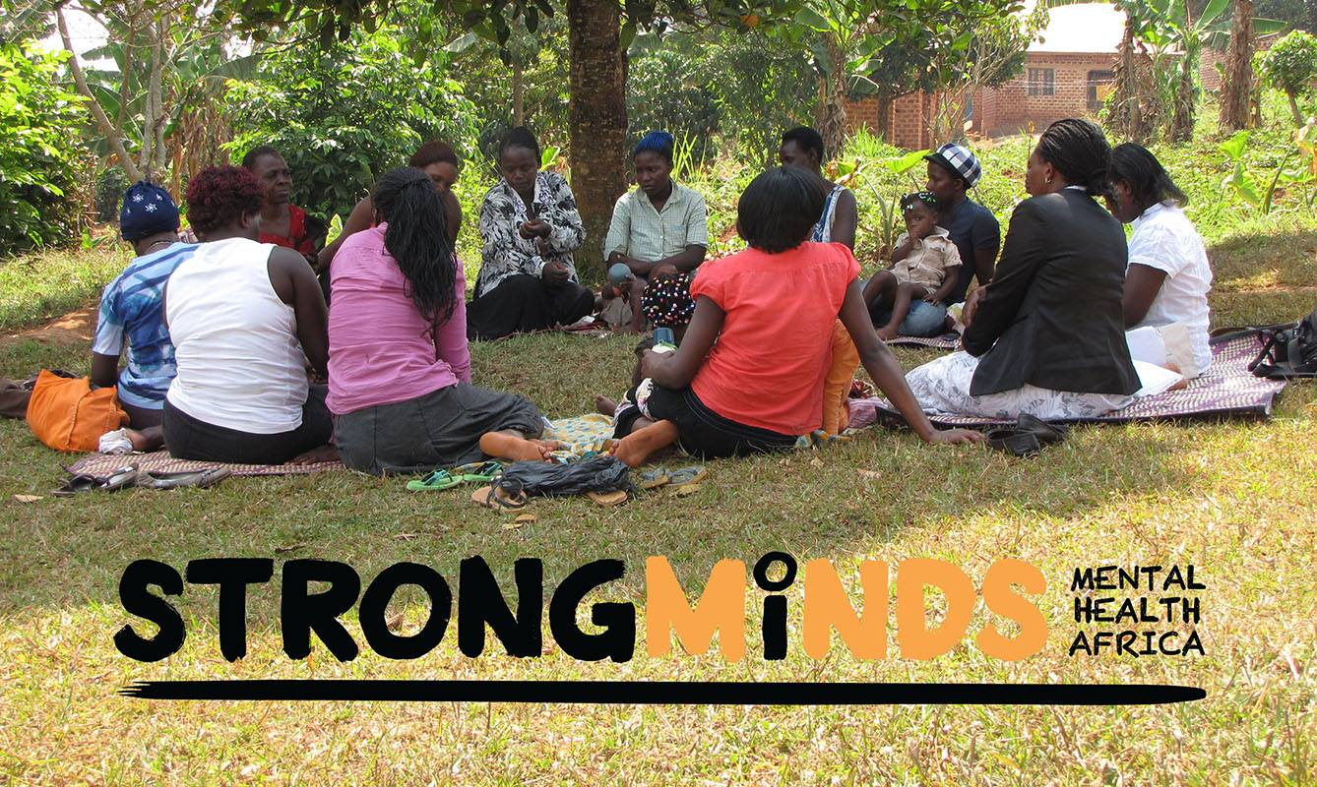
Supporting people on wait-lists for SSI disseminatioN kasujja, szkody, Sotomayor, birunji, & Schleider, under review

Slide 34
Supporting people on wait-lists for SSI disseminatioN kasujja, szkody, Sotomayor, birunji, & Schleider, under review
Fig 2. Strongminds SSC Pilot Results, individual participant depression symptom trajectories per PHQ-9 (n = 200). Dotted line reflects cut-off for likely depression.
SSC offered individually or in groups (range: 2-6) via StrongMinds, a Uganda-based organization levering lay community providers to combat depression
N = 196 service-seeking Ugandan adults, ages 18-69, with moderate or greater depression, Sept - Oct 2023
SSC offered to people on waitlists for group interpersonal psychotherapy

Slide 35
Integrating The single-session consultation into publicly-funded clinics across two states
Testing feasibility and pathways to Medicaid reimbursement for the single-session consultation (telehealth-delivered SSI for people on waiting lists) across 9 clinics in PA and CT

Slide 36
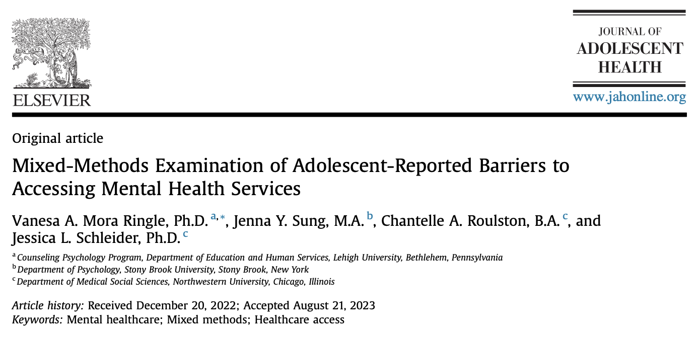
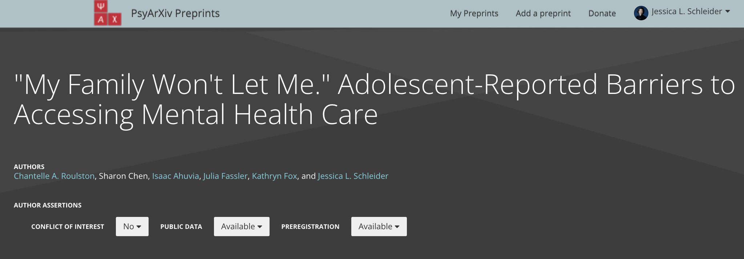
Even the most scalable supports will fail to reach youth if structural barriers persist
32-42% of teens who could not access mental health care
cited parents as primary barrier (Ns = 211, 123)
Notes:
Grants from Hopelab and NIH allowed us quantify the relationship between youth access to care and laws regarding adolescents’ ability to independently access mental health treatment,
toward streamlining youth-centered policy change.

Slide 37
do parent consent laws relate to youth access to care? (Funded by hopelab; nih office of science policy) Schleider, Smock, ahuvia, walubita, rapoport, hill, & purtle, 2024, jama pediatrics
Treatment use among adolescents with past-year depression was significantly lower in states mandating caregiver consent for professional mental health services, p = 0.002
Notes:
No matter how scalable we design our interventions to be, it WILL NOT MATTER if youth are systematically disempowered from using them.

Slide 38
Ongoing research (funded by NIH Office of Science Policy): What do youth think?
What teens say when asked about parent consent laws and ‘direct-to-teen’ supports:
“For me, I don't think it would really make much of a change just because I believe that my mom would let me. But … a lot of people's parents aren't as accepting, so it would kind of prevent them from getting the resources that they really need. It would kind of hinder the mental health of just a lot of people worldwide.”
“I’ll feel a lot better if I don’t need [my parents’ permission], because it's not my parents who are dealing with this problem it's me myself who's dealing with it. So I should be the one to choose how I should fix that problem.”
I think if you're above fifteen you should have some type of autonomy…because the chance of your parents saying no to [getting mental health care] could be devastating.”
Notes:
No matter how scalable we design our interventions to be, it WILL NOT MATTER if youth are systematically disempowered from using them.

Slide 39
5th International Symposium on Single Session Therapies (SST5)
https://sites.northwestern.edu/sst5
Notes:
They can also attend our upcoming conference to learn more and form cross-sector partnerships to promote this approach

Slide 40
Thank you!
Questions?
Our Open-Access Digital SSIs
schleiderlab.org/yes | schleiderlab.org/empower
Single-Session Consultation
Manual & Action Plan:
osf.io/xnz2t/

