Slide 1

Housing, Homelessness, and Mental Health
Jessica Kramer
2025

Slide 2

ADA Accommodation –
Countywide we are not applying ADA accommodations within behavioral health and primary care
No formal ADA Interactive Process

Slide 3
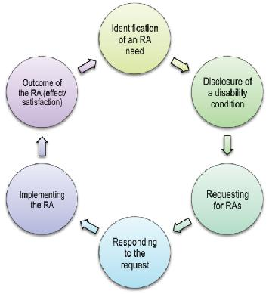
ADA Interactive Process is:
  Person with a disability or representative requests accommodation
  Assessment for Reasonableness
  Trained or certified ADA coordinator creates a remedy
  Ongoing process
  Like HR a file of the accommodation is kept for reference

Slide 4

Impact: Homeless Recovery and Housing Stability through the ADA and fair housing process
  WIN: Housing is healthcare and new CAL AIM Supportive Services
  Those without reasonable accommodation are less likely to retain primary care and access the services necessary to acquire and maintain housing.

