Slide 1
Street Medicine
Katie Wood, Family Health Centers of San Diego
Katiew@fhcsd.org

Slide 2
Disclosures
Name of Ineligible Company
Nature of Relevant Financial Relationship-N/A
Name of Ineligible Company-N/A

Slide 3
Agenda
Introductions​
SD Homelessness Stats​
What is Street Medicine?​
FHCSD services and stats
Metrics, Outcomes & Successes​
Continued Learning & Collaboration

Slide 4
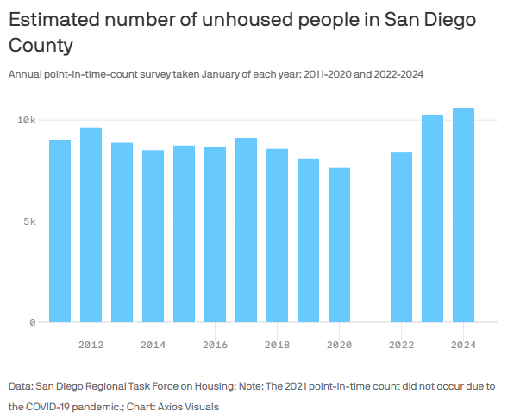
Homelessness Stats-PITC
Reference: https://www.rtfhsd.org/reports-data/

Slide 5
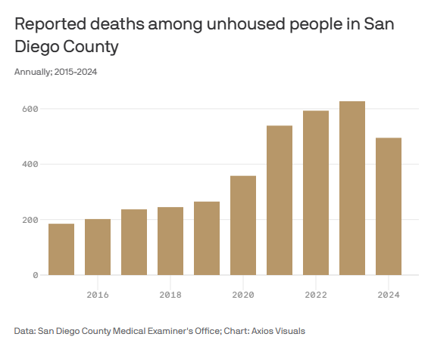
Homelessness Stats-ME’s Office

Slide 6
What is Street Medicine?
Health and social services developed to address the unique needs of individuals experiencing unsheltered homelessness, delivered directly to them in their own environment (typically places not intended for human habitation). ​
Street Medicine uses a Harm Reduction and low barrier approach to ensure all individuals have access to basic primary care needs, regardless of where they sleep.​
Street Medicine is trauma informed and focuses on relationship building to support an individual in managing their health from a whole person approach.

Slide 7
Why Street Medicine?
Using targeted outreach and engagement strategies, Street Medicine offers medical care to an extremely vulnerable and complex population of people that have not sought nor want to seek care in traditional settings including brick-and-mortar clinics with goals of:​
Reducing hospital admissions​
Offering Health Screenings designed to meet the needs of the street​
Diagnosis and Treatment of Acute and Chronic Diseases​
Substance Use Disorder screening, including Harm Reduction and Medications for Addiction Treatment (MAT)​
Screening and linkage to Mental Health Services​
Providing Wound Care​
Blood draws and other specimen collection for lab testing

Slide 8
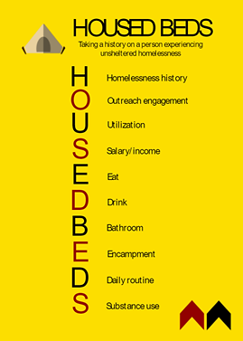
HOUSED BEDS ASSESSMENT
HOMELESSNESS
Location
Duration
OUTREACH
Engagement with services or teams
Existing support system
UTILIZATION
Health care
Social services
Judicial system
SALARY
Financial resources
EAT
Access to food
Frequency of meals
DRINK
Access to clean water
BATHROOM
Access to a toilet
ENCAMPMENT
Sleep environment
Sleep position
Sleep patterns
Time of day for sleep
DAILY ROUTINE
Activity during the day
SUBSTANCE USE
Current and past use
Frequency of use
History of overdose
Rehab experiences
BATHROOM
Access to a toilet
ENCAMPMENT
Sleep environment
Sleep position
Sleep patterns
Time of day sleep occurs
DAILY ROUTINE
Activity during the day
SUBSTANCE USE
Current and past use
Frequency of use
History of overdose
Rehab experiences
Reference: https://keck.usc.edu/news/researchers-develop-new-information-tool-to-standardize-clinical-outreach-to-unsheltered-homeless/

Slide 9
Introduction to FHCSD
FHCSD is one of the nation’s ten largest FQHCs. We operate 90 sites across San Diego County,​
Our staff provides care to over 227,000 patients each year, 91% are low-income and 29% are uninsured. We offer a range of health care services throughout the region, including:​
22 primary care clinics​
20 behavioral health facilities​
Eight dental clinics​
Five vision clinics​
Three mobile medical units​
Three outpatient substance use treatment program​
Two mobile counseling centers​
Two physical rehabilitation clinics​
Two urgent care centers​
A pharmacy

Slide 10
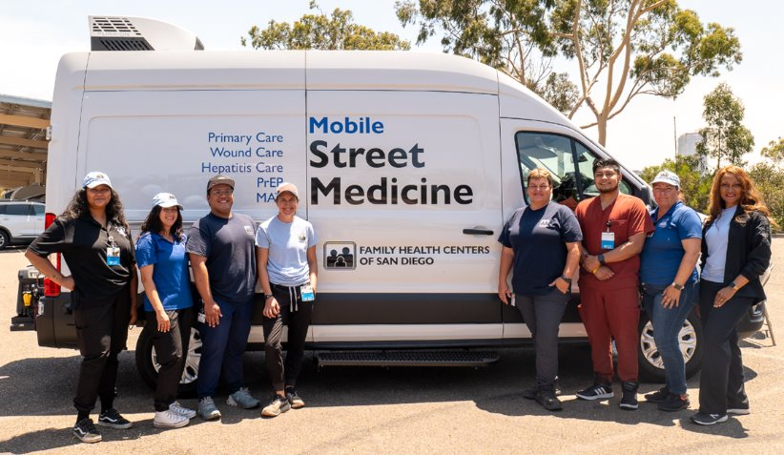
FHCSD Multidisciplinary Team
Medical provider: MD, PA or NP​
RN/LVN​
Peer Support Specialist​
Case Managers​
Substance Use Disorder Counselor​
MH Clinician ​
HIV/HCV Test Counselors​
Homeless Outreach Workers​
Medical Assistant/CPT ​
Patient Registration Staff

Slide 11
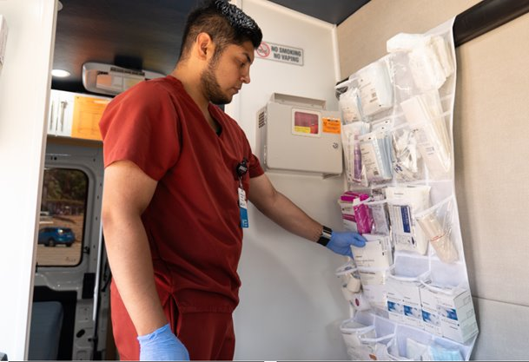
Services Provided by FHCSD
Medical care​
Mental health screening and therapy (Mobile Counseling Center)​
HIV/HCV testing, linkage to care​
PrEP navigation and linkage​
Harm Reduction services: Naloxone, Fentanyl and Xylazine Test Strip Distribution​
SUD Services including counseling, referrals to services ​
MAT Inductions​/refills
Case Management
Notes:
​

Slide 12
FHCSD Services
Calendar Year 2024:
647 unique patients served through 1835 unique medical visits
Most common visit types:
Establish primary care
Hepatitis C treatment initiation and follow up
Wound Care
Hypertension/Blood Pressure
605 unique patients served through 1320 case management visits
Most common visit types:
Case Management intake/follow up
Harm Reduction supplies
SUD/MH follow up

Slide 13
Where were the Patients Prior to Their First Street Medicine Encounter?

Slide 14
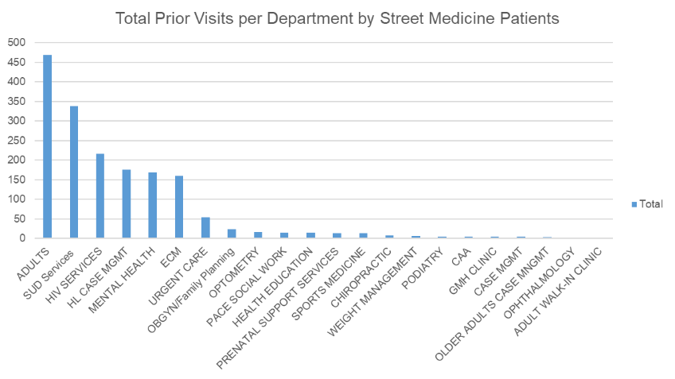
FHCSD Services To-Date
Of the 63% of patients who received services at FHCSD prior to starting with street medicine:
51% were receiving primary care services​
34% were receiving behavioral health services​
27% were receiving substance use disorder services​

Slide 15
Where do we go from here...
Service enhancements
Mental Health
Wound Care
HIV/PrEP navigation and coordination
Expansion of services
Service locations
Number of providers
Scope of services
Continued training opportunities
Residency programs
Provider training

Slide 16
Continued Learning
Other organizations, the County of San Diego and FQHC’s meet monthly to discuss:​
Process for screening for insurance/assigned PCP ​
Referral process to connect/reconnect patient with their assigned PCP ​
Services provided to those assigned to another PCP ​
Care Coordination with assigned PCP ​
Communication pathways with assigned PCP

