Slide 1
Understanding the SUD
Ecosystem: Solution Focused Opportunities for Change
April 2024
WWW.HEALTHMANAGEMENT.COM

Slide 2
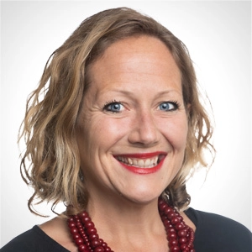
Introductions
Erin Russell
Principal
Baltimore, MD
Debbi Witham
Principal
Washington, DC
Notes:
NOTES:
Good afternoon. Thank you for joining us for our first in a series of webinars about Understanding the substance use disorder ecosystem, where we are discussing solution-focused opportunities for change.
I’m Lisa Braude, and I am your facilitator for today.
I am a Principal Consultant out of the HMA Boston Office, and I provide system redesign policy and strategy consulting services to states.
I am going to hand it off to my panelists to introduce themselves. Anika, is not joining us today, so I will start with Teresa.
Will each of you please briefly introduce yourselves and provide brief introduction about your area of focus related to the SUD ecosystem?

Slide 3
Financial Disclosure
Harm Reduction Therapeutics, the manufacturer of the 3 mg naloxone nasal spray RiVive® is a client of Health Management Associates.
The presenters otherwise have no conflicts of interest to disclose.

Slide 4
Learning objectives
Explain the differences between prevention, promotion and harm reduction
Define harm reduction
Identify at least three opportunities to integrate harm reduction into clinical practice for individuals living with SUD
Examine challenges to applying a harm reduction approach in clinical practice

Slide 5
Presentation overview
A provocative conversation based on the latest evidenced based research and innovation with leaders in the field of SUD and OUD
An opportunity to spark solution focused approaches to the continuing public health epidemic that continues to take lives every day
A high-level overview of the many facets that make up the SUD Ecosystem that go beyond assessment, treatment and supports to include prevention and health promotion
An understanding of the continued need to be community centric and equity focused
Notes:
Lisa
Our team at HMA sees it as an imperative to push for better outcomes and to move swiftly to save lives. As we work across the country with communities, providers, and government partners, we see opportunities for shifting mindsets from what’s not working to innovative and responsive solutions for the future.
We want to make a call to action for change - we want to offer hope, and we want to inspire conversation to encourage discourse about different perspectives and different experiences to work together to change the trajectory.

Slide 6
Ecosystem approach overview

Slide 7
WHY WE ARE HERE—PEOPLE ARE CONTINUING TO DIE
The SUD crisis is not improving…
2020 | 2021 | 2022
40.3 million (14.5%) Americans ages 12 and older were diagnosed with a substance use disorder in the past year. | 43.7 million (15.6%) Americans ages 12 and older were diagnosed with a substance use disorder in the past year | 48.7 million (17.3%) Americans ages 12 and older were diagnosed with a substance use disorder in the past year
In a 2022 survey, 4 in 10 Americans who needed SUD treatment did not receive it
Drug Overdose Deaths Among Adolescents
723
253
Among those who did receive care, 8 in 10 report difficulties getting the care they needed
2018
2022
Drug overdose deaths nearly tripled in 4 years
57 percent (2019) and 78 percent (2022) of these deaths involved opioids
Sources: United States National Survey on Drug Use and Health (NSDUH) 2020-2022 Survey Data; KFF “Recent Trends in Mental Health and Substance Use Among Adolescents”
Notes:
Lisa
The reason we are here today is because people are continuing to die from using drugs.
And more young people are not afraid to use opioids.
Despite federal, state, and local efforts to reduce supply and demand, we have a growing drug epidemic, with a behavioral health workforce shortage and a treatment access problem.

Slide 8
Levers to Drive Change to more effective approaches
Funding
Grant resources, opioid abatement resources, Medicaid/Medicare, commercial insurance
Policy & State Legislation
Attitudes & Stigma
Licensing / Accreditation
State, Federal, County
Notes:
Teresa – strategies to drive transformation

Slide 9
Guiding principles: Pivoting to save lives
Act Differently
Be Accountable
We have an imperative to think & act differently.
See each interaction as life and death- Be accountable to the care for each individual and ensure there are no wrong doors by embracing navigation and continuity of care.
Build System Thinking
Empower Change
Empower change through equity grounded, person centered and community driven approaches that respond to what individuals want and need.
Building system thinking for a comprehensive and interconnected spectrum of engagement and treatment strategies.
Notes:
Linda- Overarching framework

Slide 10
Empower change
Empower change through equity grounded, person centered and community driven approaches that respond to what individuals want and need.
Equity Grounded
Person-Centered
Community-Driven
Everyone has a fair and just opportunity to be healthier
Acknowledges why disparities and obstacles exist in order to address them and their consequences
Engages policy to address structural drivers of inequity
Incorporates community voice and storytelling
Considers unique needs of each individual
Individualizes care while recognizing best practices/successful approaches
Addresses the broad spectrum of needs for overall health and well-being comprehensive
Community centered- solutions should be grounded in the unique features and resources of each community
Led by community
Stakeholders will use their levers differently
Stakeholders may need to expand their services.

Slide 11
No wrong door

Slide 12
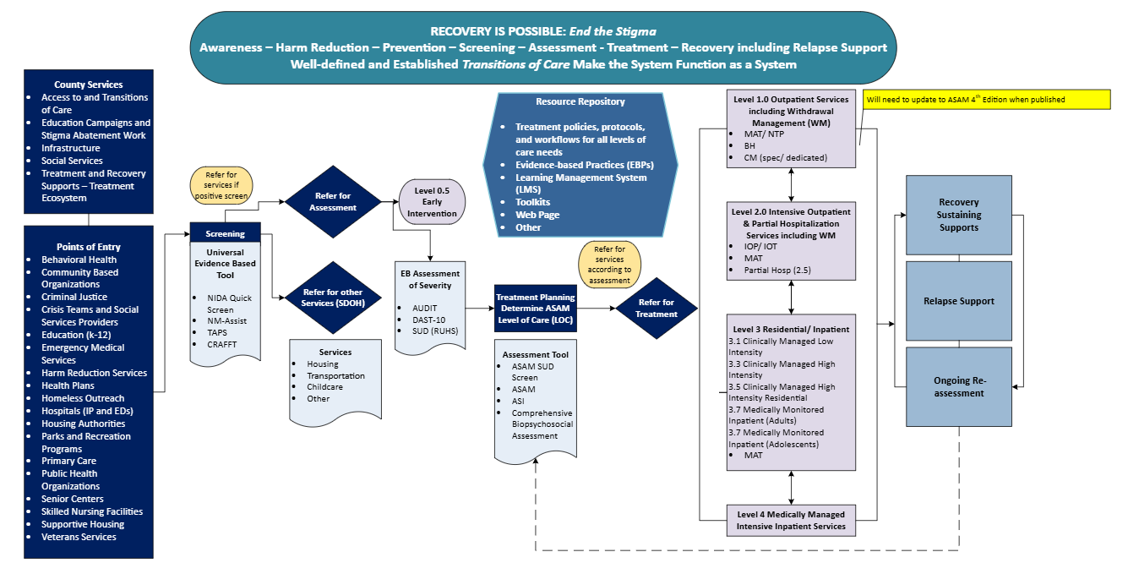

Slide 13
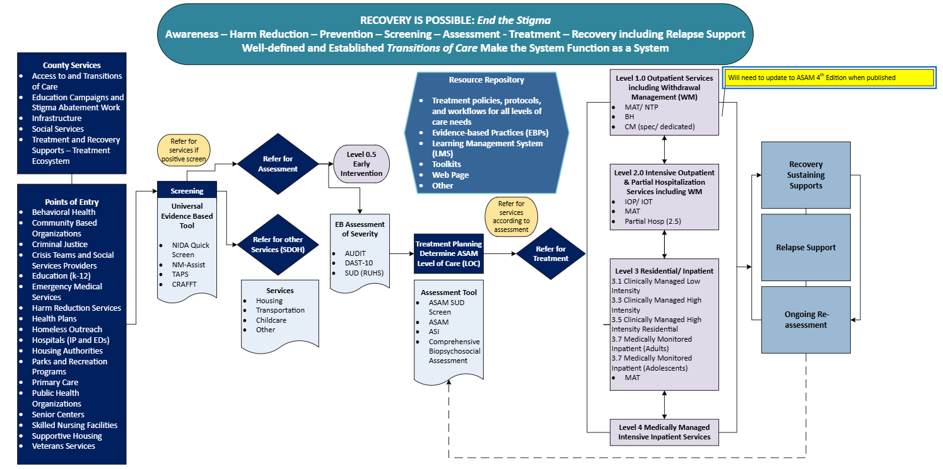

Slide 14
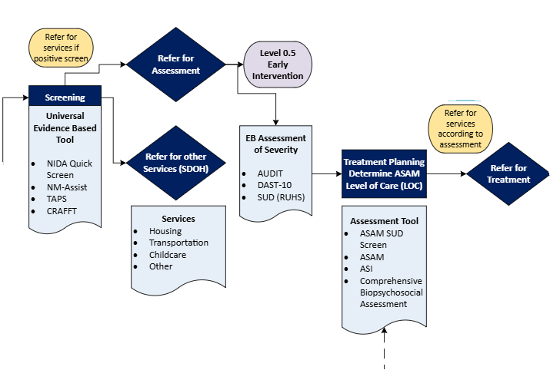

Slide 15
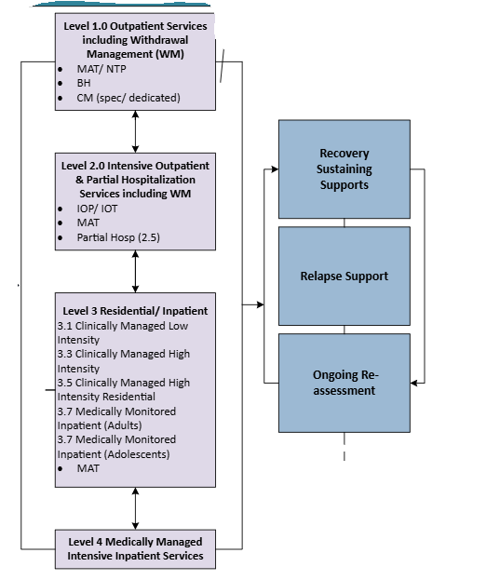

Slide 16
Five C’s of Ecosystem

Slide 17
Person Centered Approach/ Harm Reduction Principles

Slide 18
Radical Neutrality
“practice radical neutrality; grapple with ethical gray areas; tolerate, accept, and understand difficult behaviors; be taught by our clients; relinquish the role of authority, judge, or expert; [and] partner with clients”
Pat Denning and Jeannie Little
Co-Founders of the Center for Harm Reduction Therapy

Slide 19
Harm Reduction…
https://harmreduction.org/about-us/principles-of-harm-reduction/
Notes:
https://harmreduction.org/about-us/principles-of-harm-reduction/

Slide 21
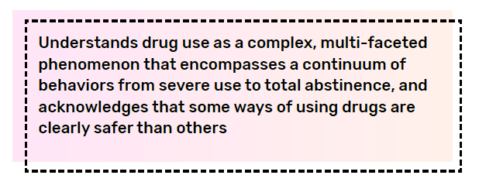
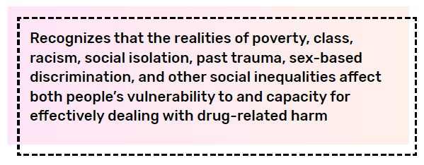
Harm Reduction…
https://harmreduction.org/about-us/principles-of-harm-reduction/

Slide 22
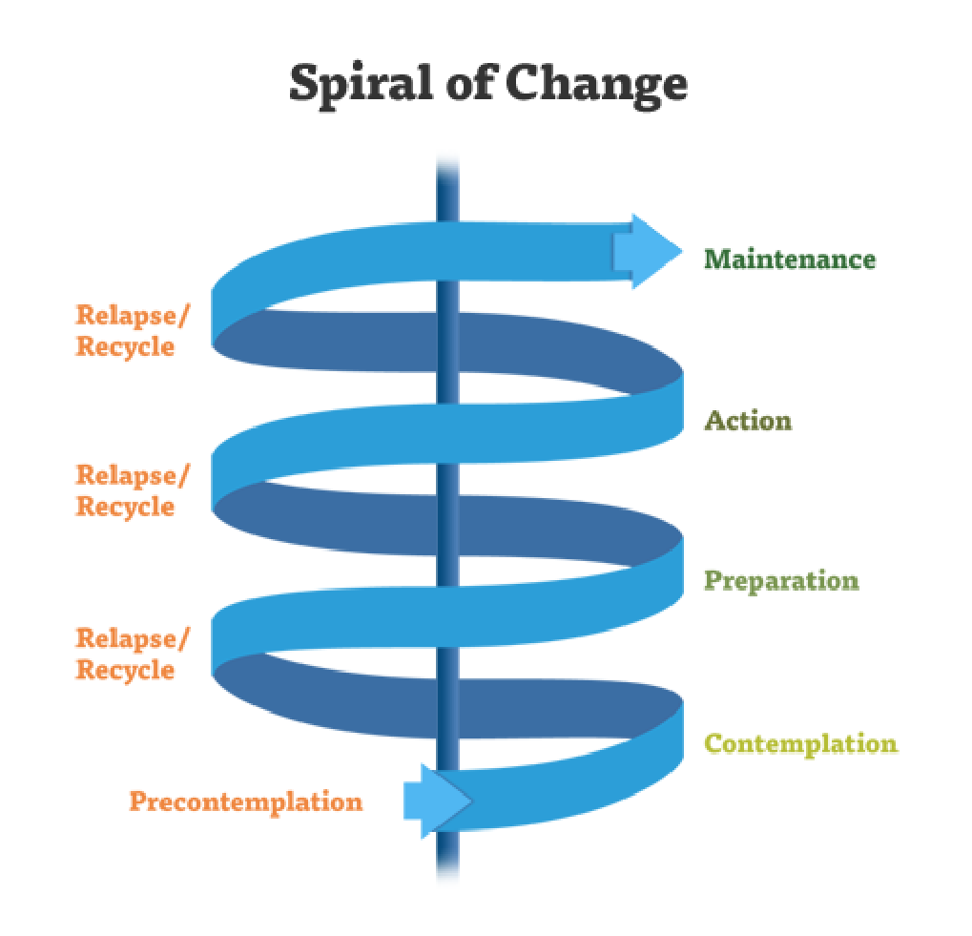
Stages of Change/ Transtheoretical Model
Change is gradual
Change is cyclical and constant
Change is progressive and sequential through stages
Relapse is likely and still progress
Meet people at their stage not yours
Prochaska, DiClemente & Norcross - 1992
Notes:
Meeting People Where They Are – includes meeting them at the Stage of Change that they are in
Notes:
The Transtheoretical Model
Change is gradual: It's important to keep in mind that while change is possible/inevitable will take time. Its important to keep in mind that addiction is surface level and that many of the underlying factors (trauma, lack of access, poverty, stigma, etc) will need adequate time and resources to address effectively.
Change is cyclical and constant: Change is a process/event that happens throughout our lives. For drug users it is important to keep in mind that many have the will power but lack the resources (employment, treatment, healthcare, etc.) that are needed to create/sustain change.
Change is progressive and sequential: There are steps/stages within the change process that move individuals forward on their path to recovery.
Relapse is likely and still progress: This model also challenges a prevailing notion concerning relapse and its role in the process of change. Often times relapse is discussed in a way that further shames individuals impacted by addiction and could lead them to return to chaotic drug use. However, under the Transtheoretical Model relapse is seens as an event/behavior that is likely, but one that won’t prevent growth.
Important to meet people at their stage not yours: Not only helps us understand the different stages of change, but it also reminds us that interventions must be tailored in ways that meet people at their stage of change. For example, interventions such as medication assisted treatment are effective at meeting individuals with a opioid use disorder where they are in their stage of recovery/change.

Slide 23
Case study

Slide 24
FQHC Client
Rose is a 48-year-old cis-gender Latinx female receiving care at your FQHC. She is currently diagnosed with high blood pressure and diabetes. She struggles with adherence and attending appointments. Rose is currently living in an encampment and uses fentanyl and methamphetamine daily. She is seeking care today as a follow-up to an inpatient hospitalization for an infection. The hospital started Rose on buprenorphine, and she would like to continue her current dose. She reports her last hospitalization scared her and she is ready to stop using fentanyl and feels her current dose really manages her cravings. She is not interested in stopping methamphetamine use- she feels it helps her in her activities of daily living. She is not interested in seeking housing services as the last case manager she met with was judgmental and the encampment feels like home.

Slide 25
Reflection Questions
What was your first impression of the individual described?
What assumptions did you make about their character, lifestyle, and choices?
How do you think society views this individual, and why?
Where do you think your views come from?

Slide 26
FQHC Client
The shelter in your community calls your front desk to schedule an appointment for Dorothy. She resides in their shelter and recently learned she is pregnant. She is using fentanyl and cannabis. Her current income is through commercial sex work. The shelter is referring her as they understand you provide MAT. Dorothy is interested in exploring her options. She would like to stop using fentanyl but will not stop using cannabis as it helps to manage her anxiety.

Slide 27
Reflection Questions
What was your first impression of the individual described?
What assumptions did you make about their character, lifestyle, and choices?
How do you think society views this individual, and why?
Where do you think your views come from?

Slide 28
Possible Support for case study patients
Equity-grounded
Nonjudgemental approach
Active listening, open-ended questions
Learning why they use drugs, how it serves them, and what motivates them to change
Person-centered
Consider co-occurring disorders
Infectious disease testing and treatment
Improve provider communication
Community-Driven
Consider the community resources available to them
Consider the context in which they live and how that may influence change

Slide 29
Thank you

Slide 30
References
Paquette CE, Daughters SB, Witkiewitz K. Expanding the continuum of substance use disorder treatment: Nonabstinence approaches. Clin Psychol Rev. 2022 Feb;91:102110. doi: 10.1016/j.cpr.2021.102110. Epub 2021 Nov 26. PMID: 34864497; PMCID: PMC8815796.
Waite MR, Heslin K, Cook J, Kim A, Simpson M. Predicting substance use disorder treatment follow-ups and relapse across the continuum of care at a single behavioral health center. J Subst Use Addict Treat. 2023 Apr;147:208933. doi: 10.1016/j.josat.2022.208933. Epub 2023 Jan 6. PMID: 36805798.
Crable EL, Drainoni ML, Jones DK, Walley AY, Milton Hicks J. Predicting longitudinal service use for individuals with substance use disorders: A latent profile analysis. J Subst Abuse Treat. 2022 Jan;132:108632. doi: 10.1016/j.jsat.2021.108632. Epub 2021 Sep 28. PMID: 34607732.

